Slide 1

Cycling Analytics
Meeting 19 April 2021

Slide 2
Recap

Slide 3

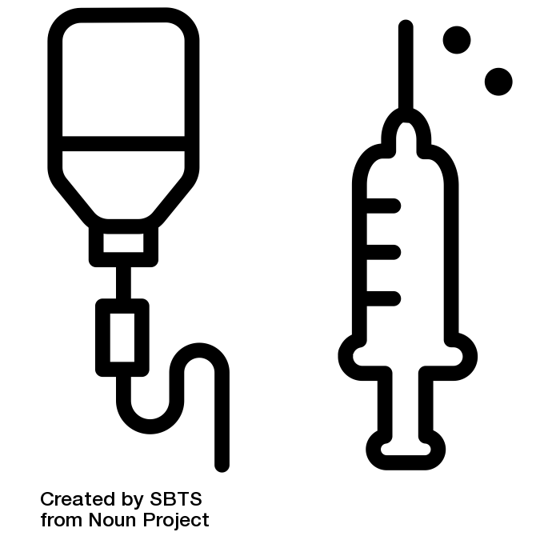
Overview
Cycling
Glucose

Slide 4
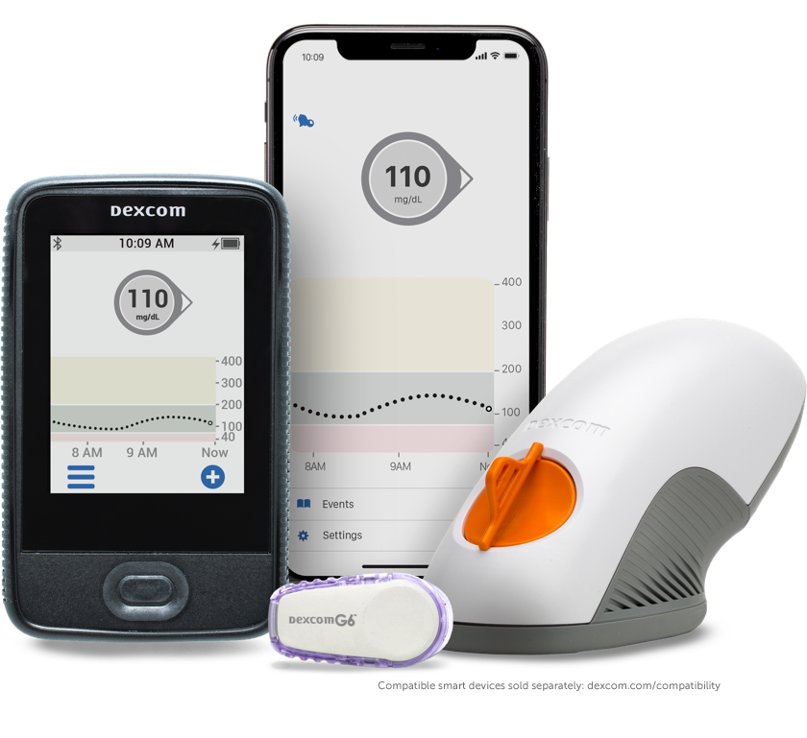


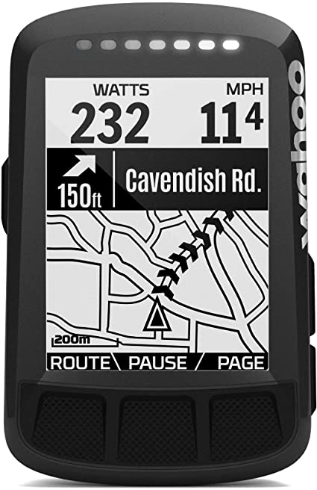
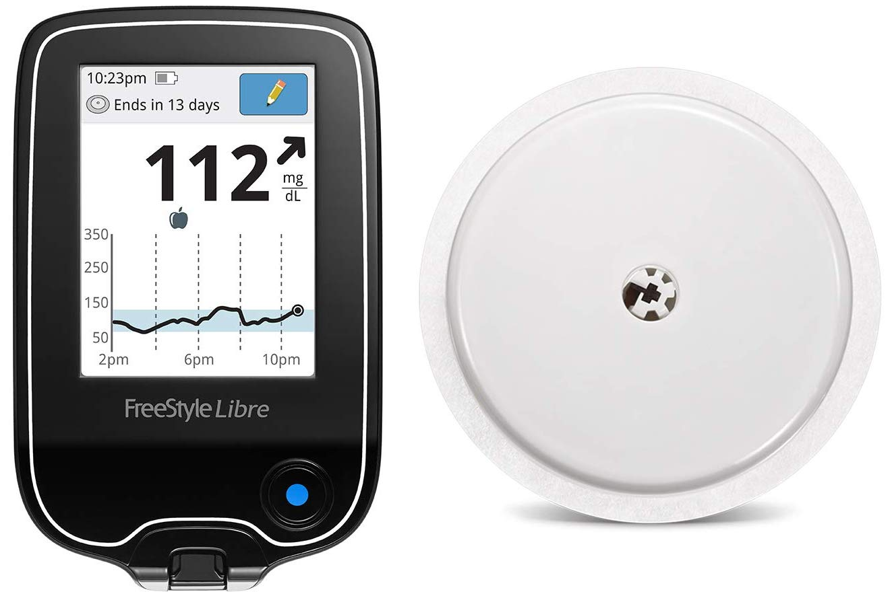
Devices
Cycling
Glucose
dexcom
june 2020
heart rate power bike computer
libre

Slide 5
Platforms
Cycling
Glucose
dexcom
june 2020
heart rate power bike computer
libre
TrainingPeaks (sec)
Dexcom (min)

Slide 6
Objective
Support patients with Type 1 Diabetes (TNN riders) in glucose management during exercise
General insights in glucose levels in-, during- and after training sessions through descriptives
Association of training sessions with time spent in glucose levels
Predict future glucose levels based on current and past glucose and current and past exercise.

Slide 7
Objective
Today
Support patients with Type 1 Diabetes (TNN riders) in glucose management during exercise
General insights in glucose levels in-, during- and after training sessions through descriptives
Association of training sessions with time spent in glucose levels
Predict future glucose levels based on current and past glucose and current and past exercise.
Update: changes w.r.t. previous meeting
Insights in data through descriptives

Slide 8
Update

Slide 9
Update: Changes in data
Use 2019 data instead of 2020 data because:
Has been used before in research projects
Patient consent forms
No covid
Easier platform (dexcom instead of libre)
⇒ 11 athletes for season 2019 (1 dec 2018 - 30 nov 2019)

Slide 10
Data completeness: TrainingPeaks
11 riders for season 2019 (1 dec 2018 - 30 nov 2019)
Which training sessions do we exclude (so far)?
If there is no file in TrainingPeaks or the file is broken
No data about timezone available (not in file or from location)
Device selection: ELEMNT (BOLT/ROAM), Zwift
Files that are recorded simultaneously (duplicate timestamps)

Slide 11
Data completeness: TrainingPeaks
11 riders for season 2019 (1 dec 2018 - 30 nov 2019)
Which training sessions do we exclude (so far)?
If there is no file in TrainingPeaks or the file is broken
No data about timezone available (not in file or from location)
Device selection: ELEMNT (BOLT/ROAM), Zwift
Files that are recorded simultaneously (duplicate timestamps)
Current issues
Timezone from file and timezone from location differ in ~10 training sessions per rider
A few training sessions are copied from one rider to the other
Match data with training calendar file, to check if all training sessions overlap
Training sessions under 20 min

Slide 12
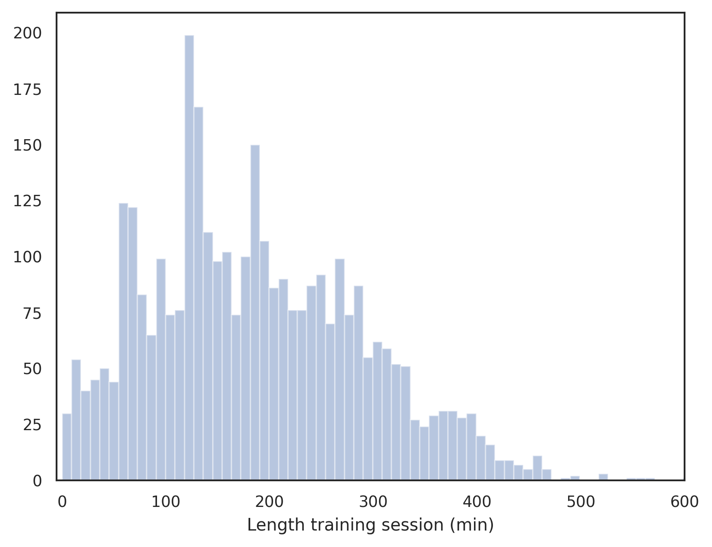
TrainingPeaks: length of training sessions

Slide 13
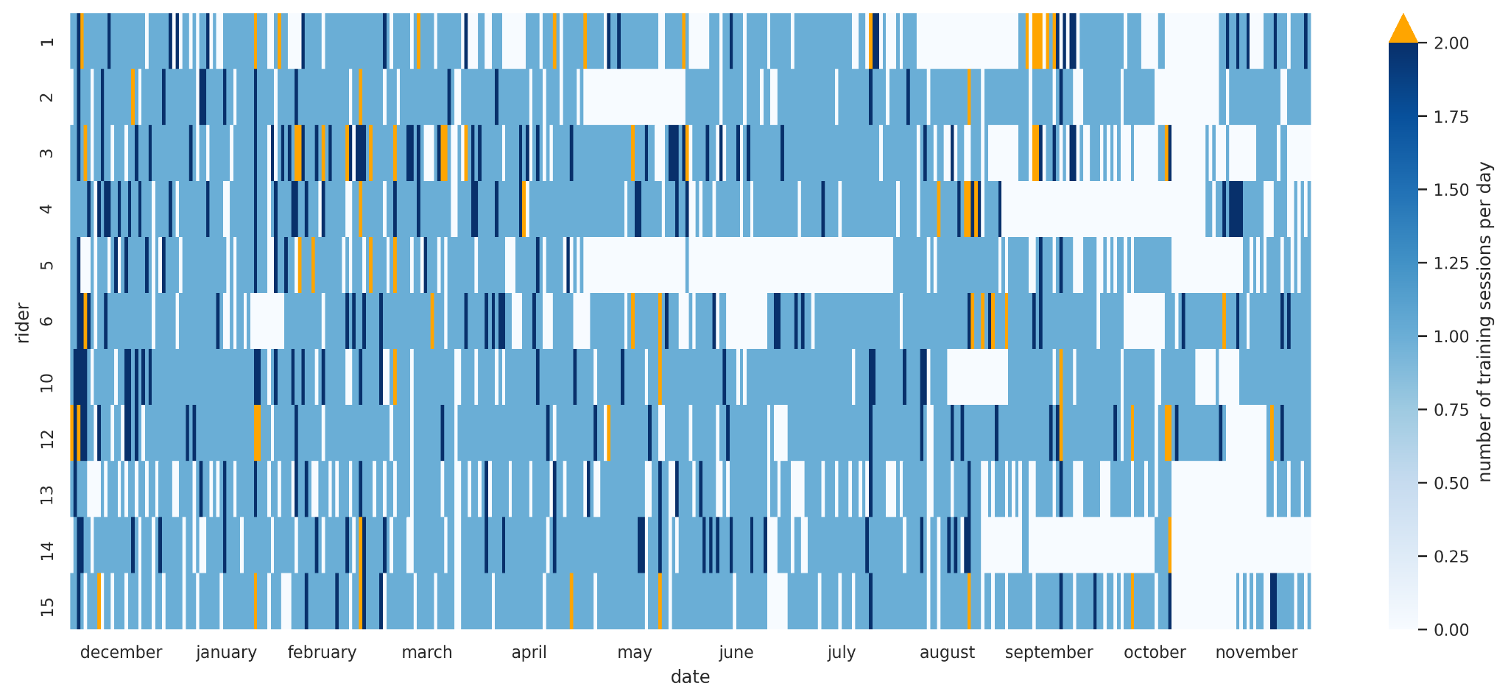
Data completeness: TrainingPeaks
For each rider, number of training sessions per day

Slide 14
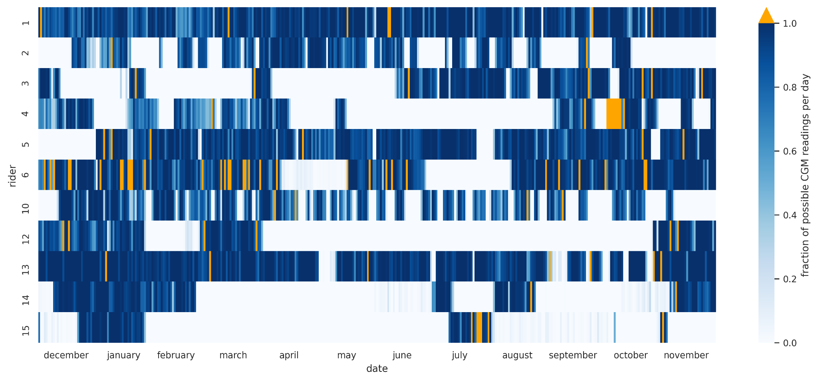
Data completeness: Dexcom
For each rider, fraction of possible CGM readings per day

Slide 15
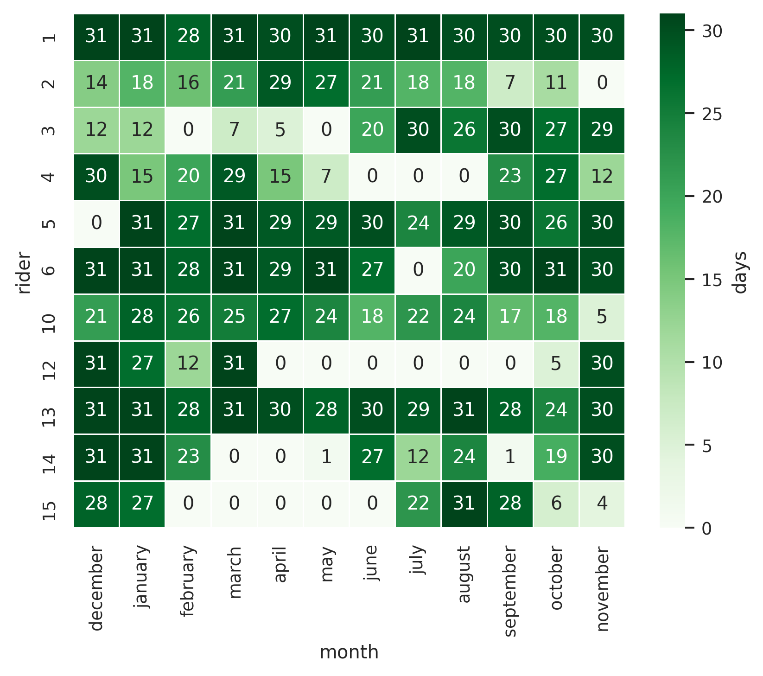
Data completeness: Dexcom
For each rider, number of days per month for which there is glucose data
Open issues:
Select days with >70% of possible glucose readings over two week period?
Why can there be more glucose readings than 288?
Readings: “High” and “Low”
Exclude calibration measurements?
Why are there glucose values in TrainingPeaks that are not in Dexcom

Slide 16
Glucose descriptives

Slide 17
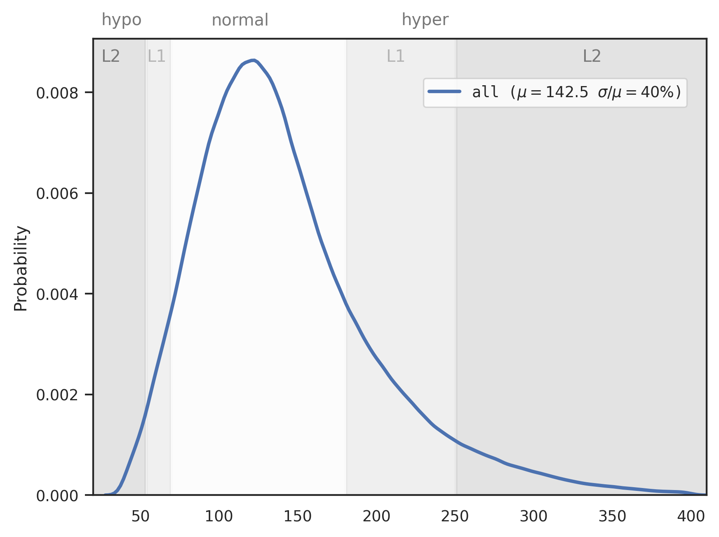
Glucose distributions
For all riders
Entire day
⇒ stratify
Glucose Value (mg/dL)

Slide 18
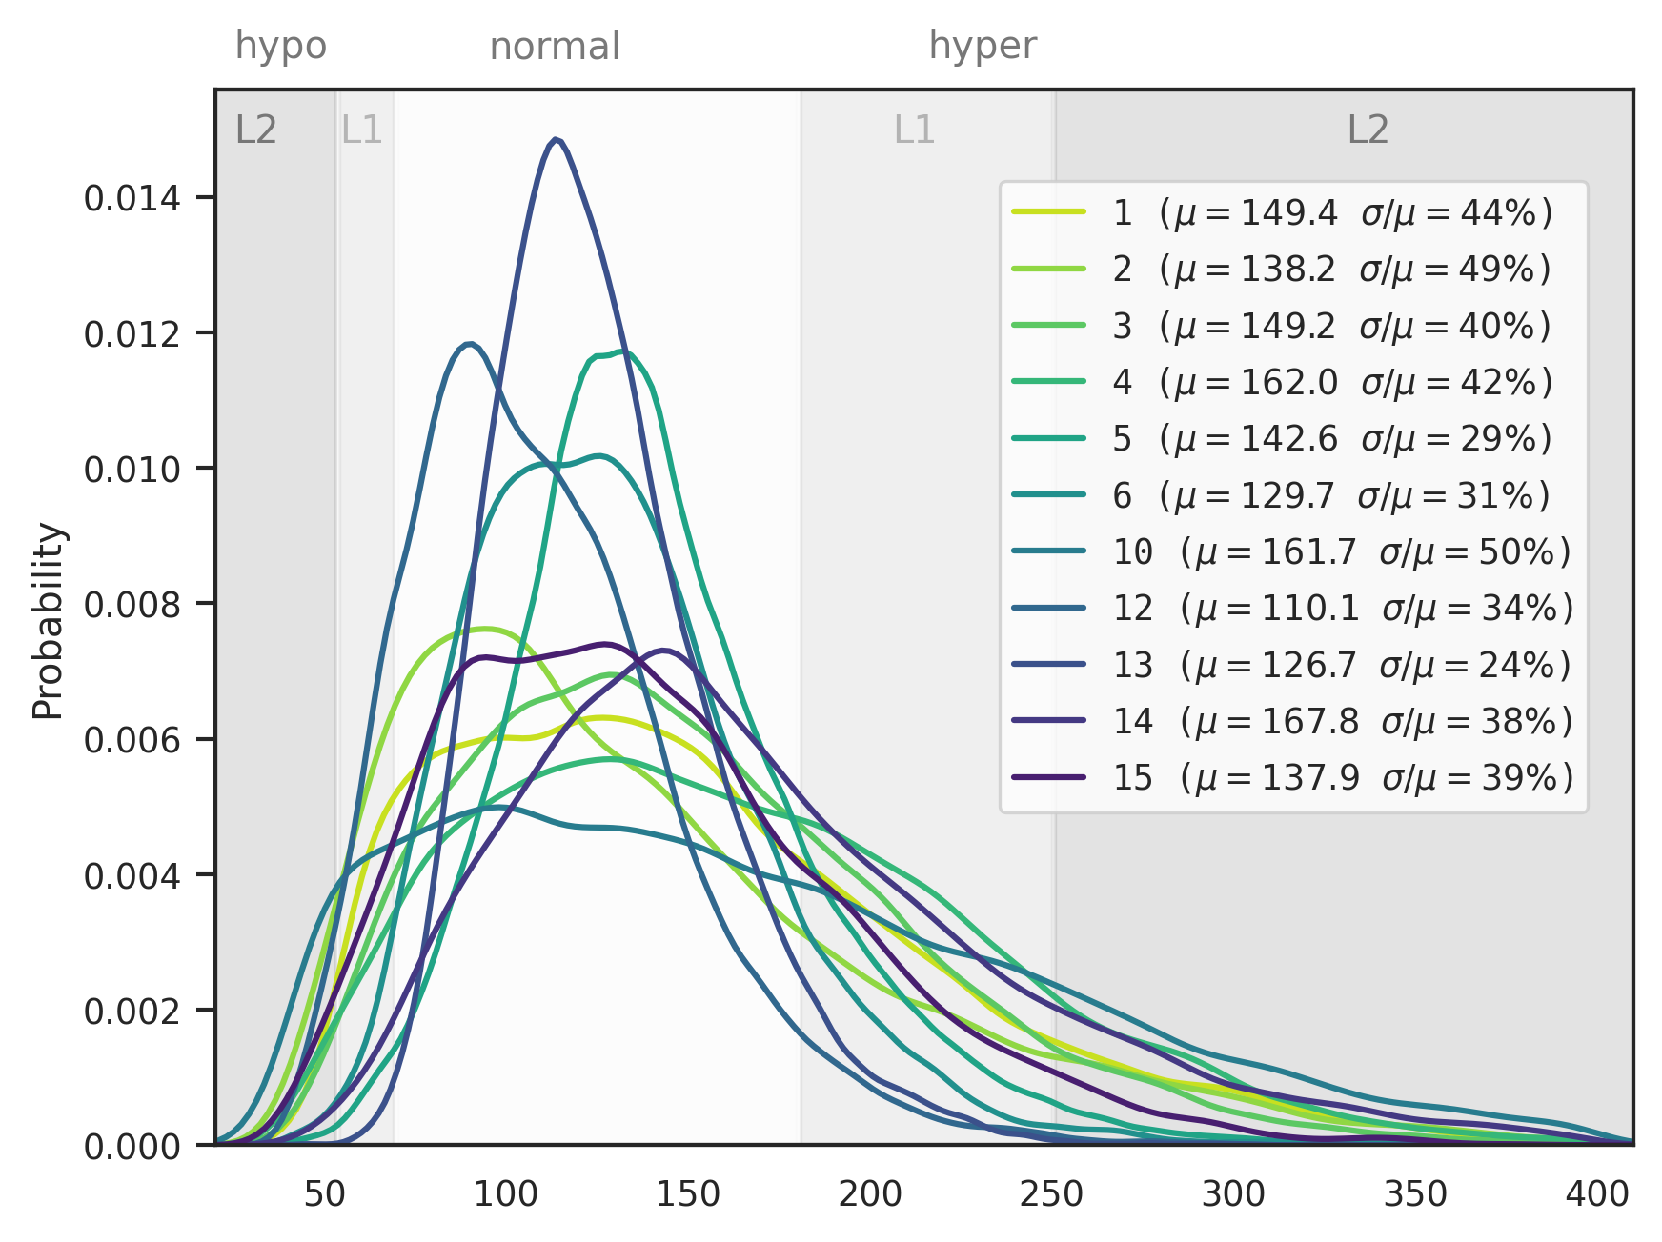
Glucose distributions
By rider
Glucose Value (mg/dL)

Slide 19
Glucose distributions
By rider
Glucose Value (mg/dL)

Slide 20
Glucose distributions
By rider
Glucose Value (mg/dL)

Slide 21
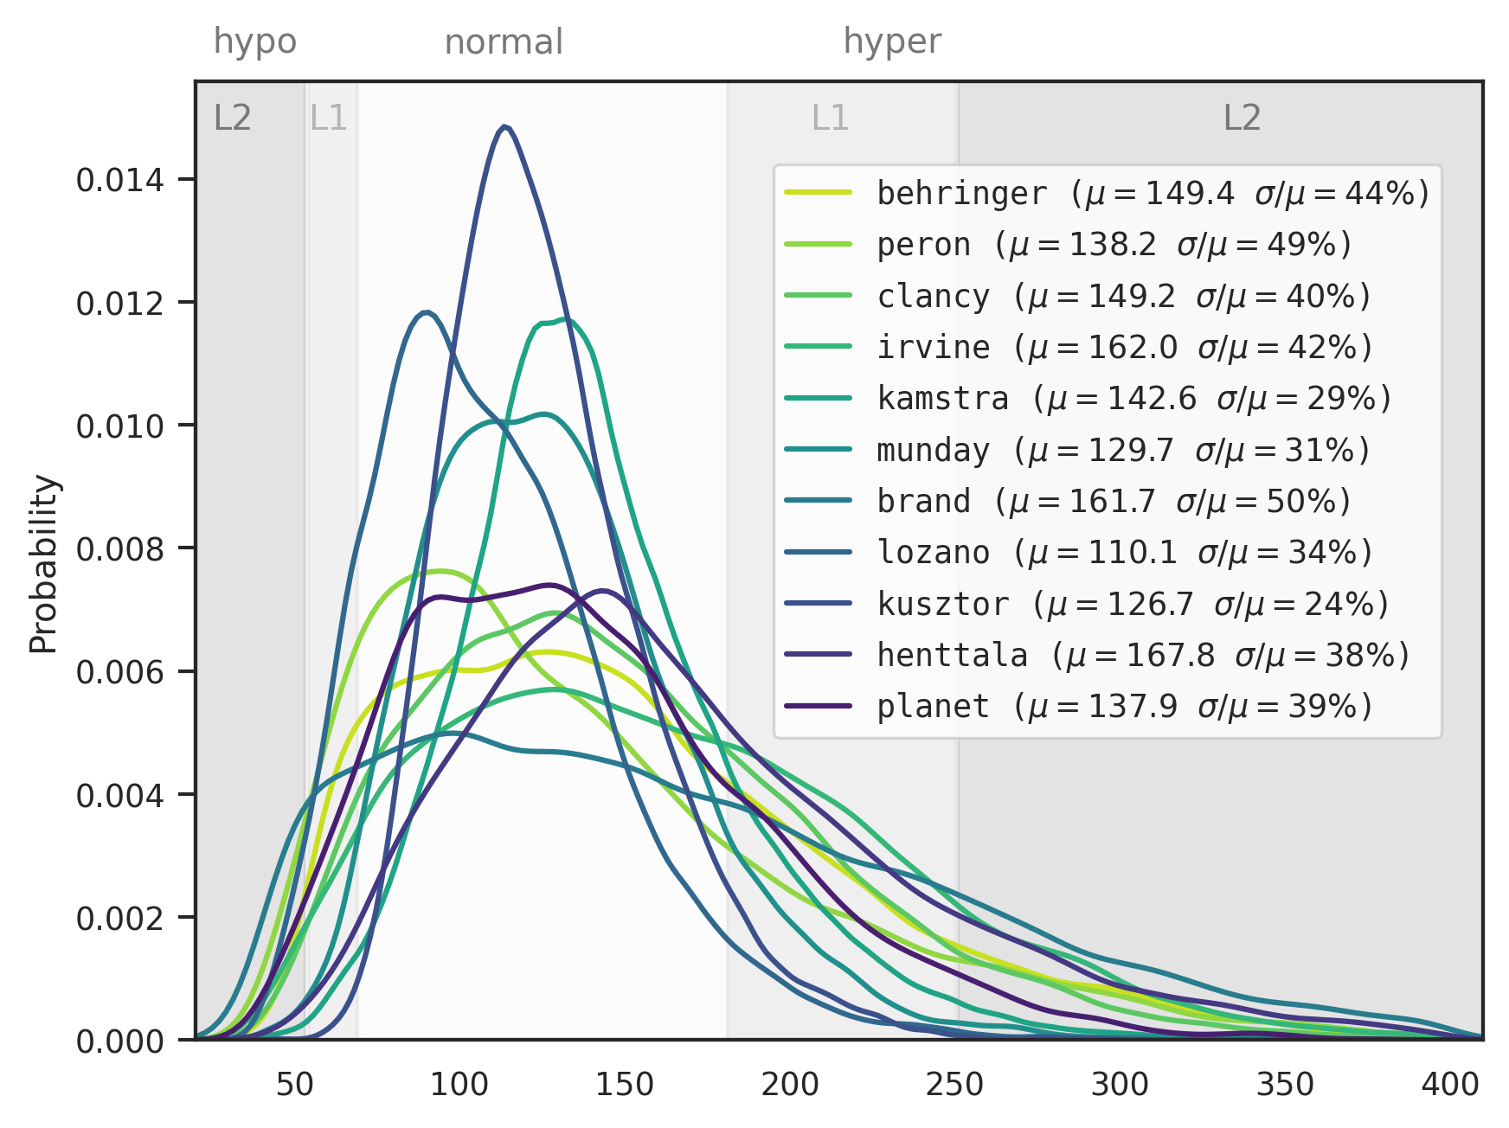
Glucose distributions
By rider
Glucose Value (mg/dL)

Slide 22
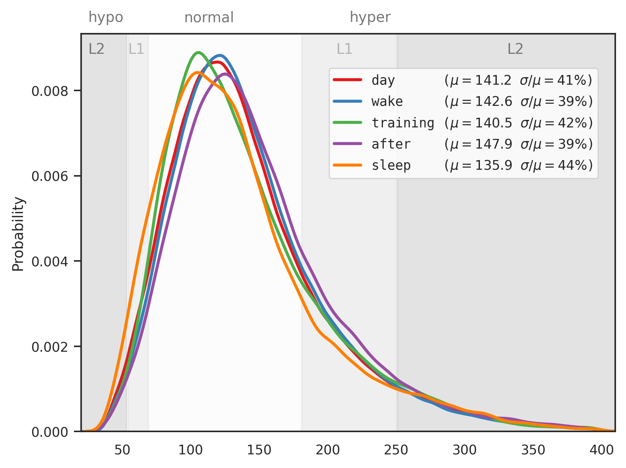
Glucose distributions
Stage | Glucose reading selection
day | 0:00-24:00h on days of training sessions
wake | 6:00-24:00h on days of training sessions
training | time of training sessions
after | 4h after training sessions (exclude time second training session)
sleep | 0:00-6:00h on night after training sessions
Note: training sessions are not excluded from day, wake and sleep
For all riders combined
⇒ stratify
Glucose Value (mg/dL)

Slide 23
Glucose distributions
Stage | Glucose reading selection
day | 0:00-24:00h on days of training sessions
wake | 6:00-24:00h on days of training sessions
training | time of training sessions
after | 4h after training sessions (exclude time second training session)
sleep | 0:00-6:00h on night after training sessions
Note: training sessions are not excluded from day, wake and sleep
For all riders combined
⇒ stratify
Glucose Value (mg/dL)

Slide 24
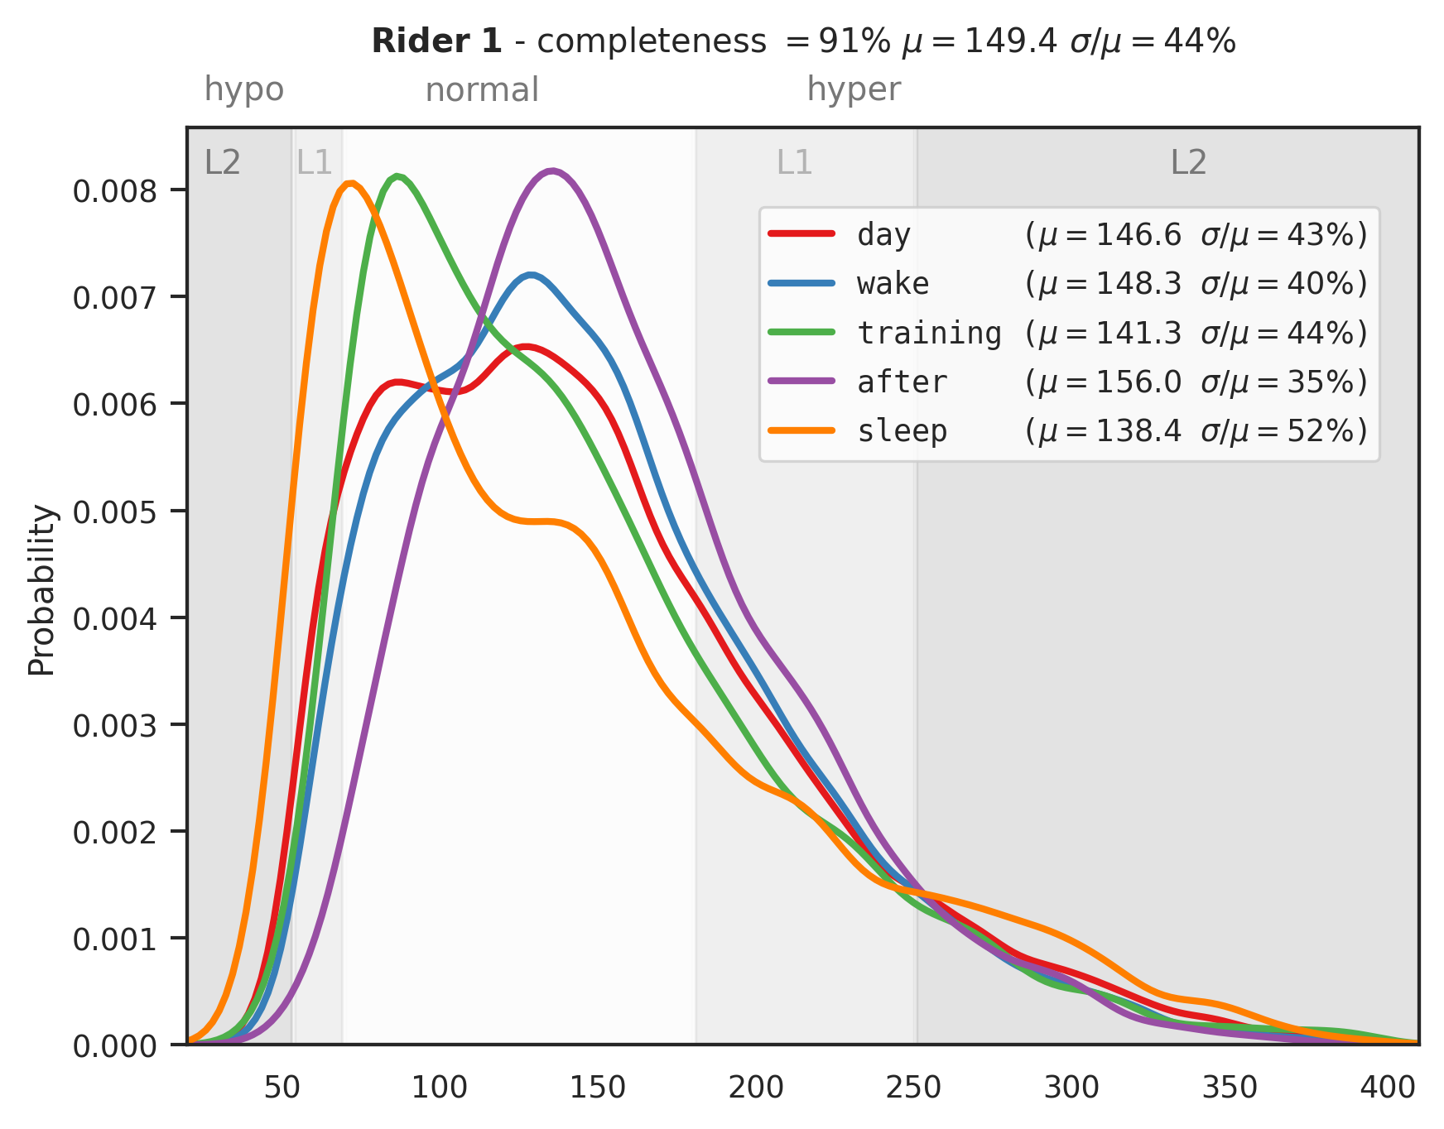
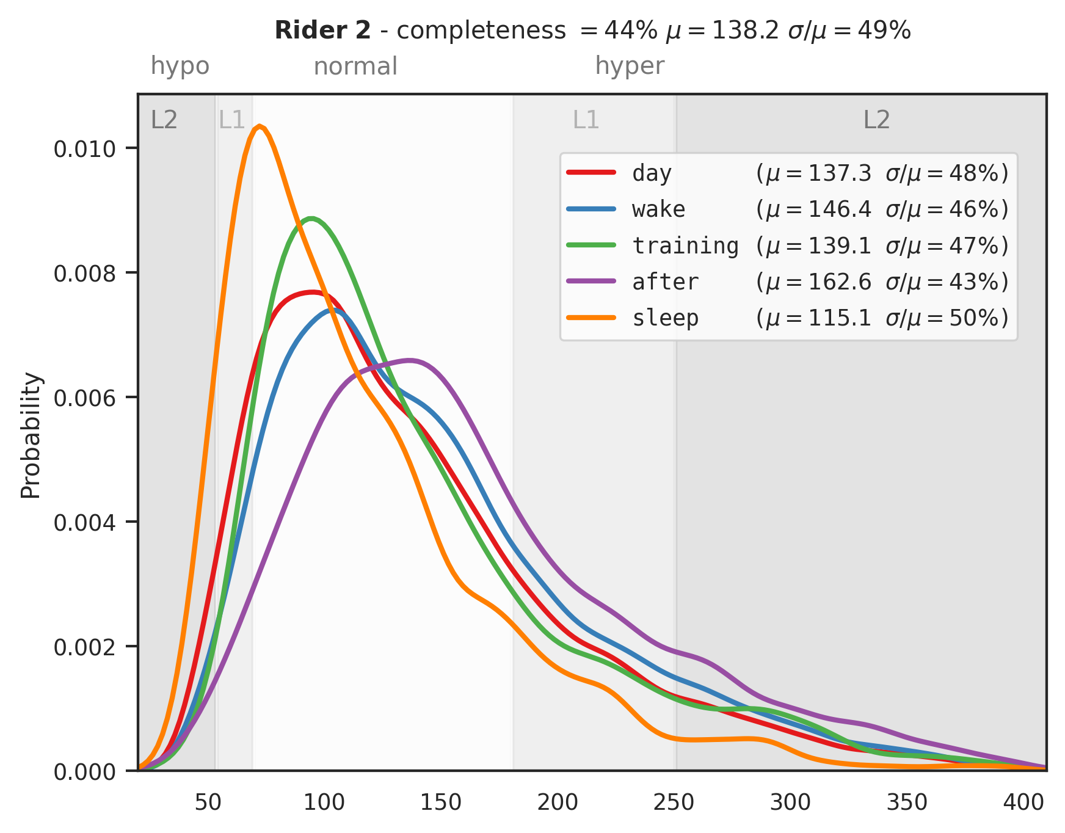
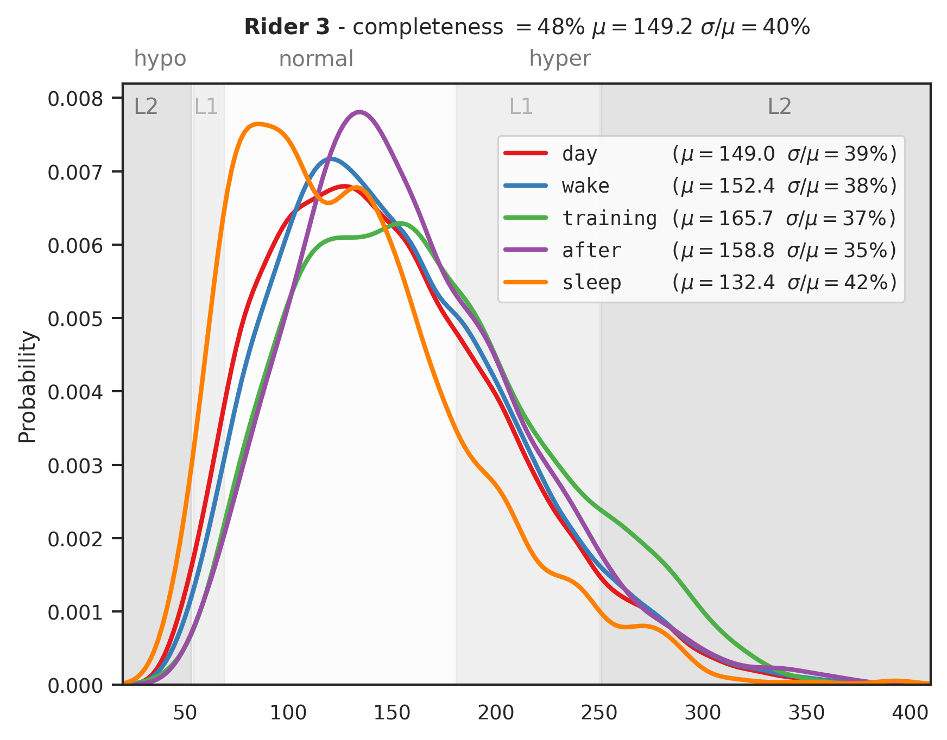
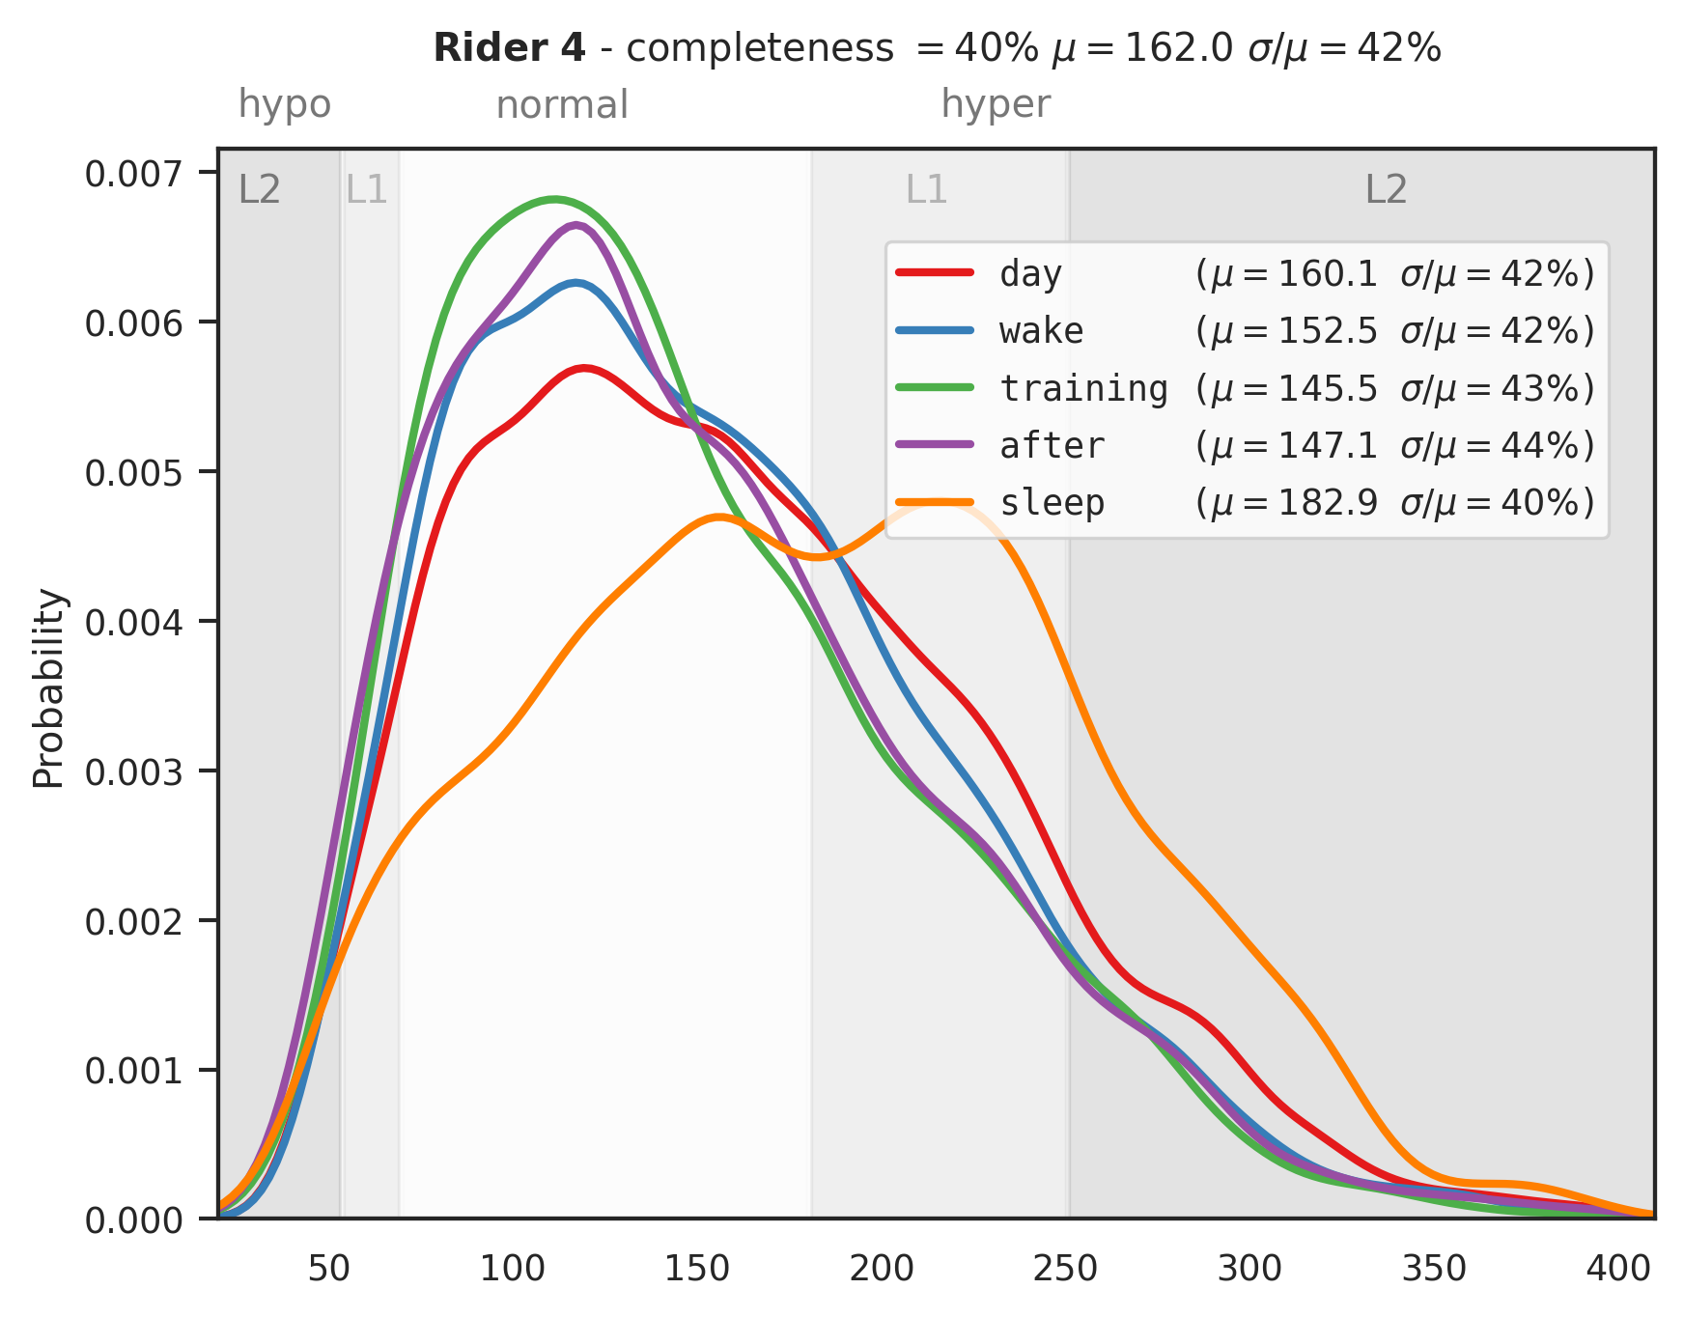
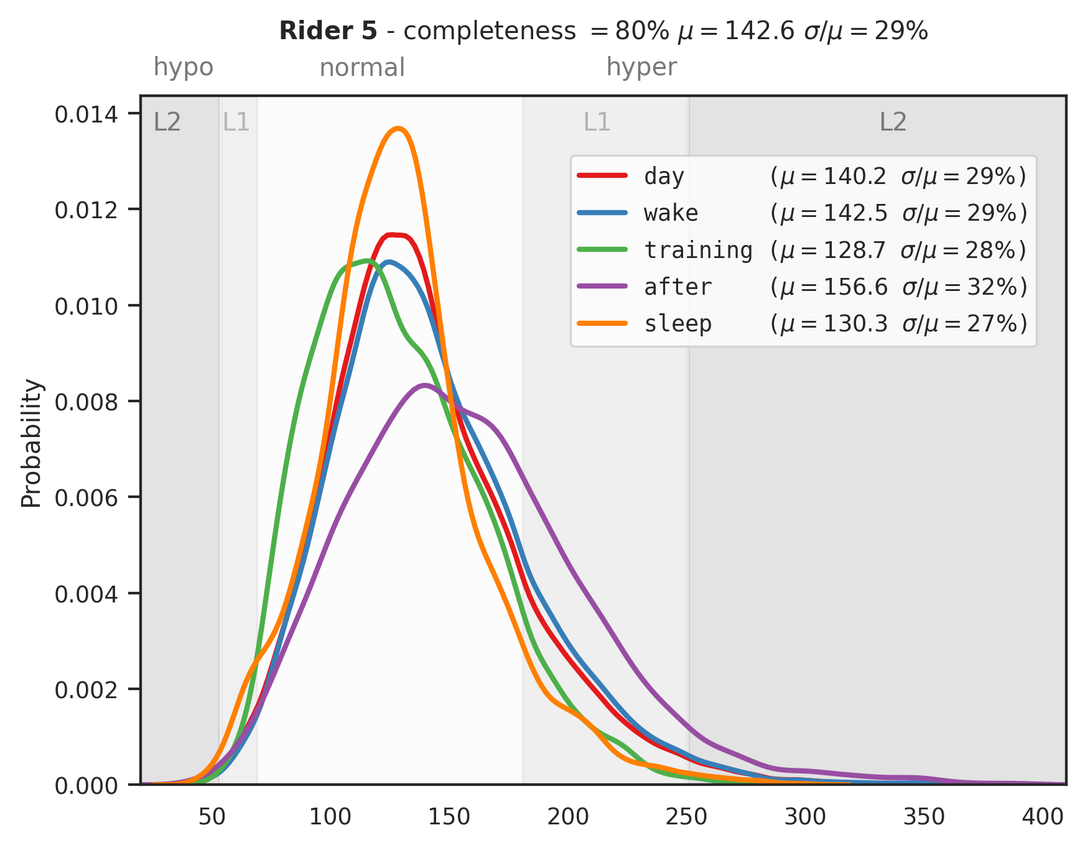
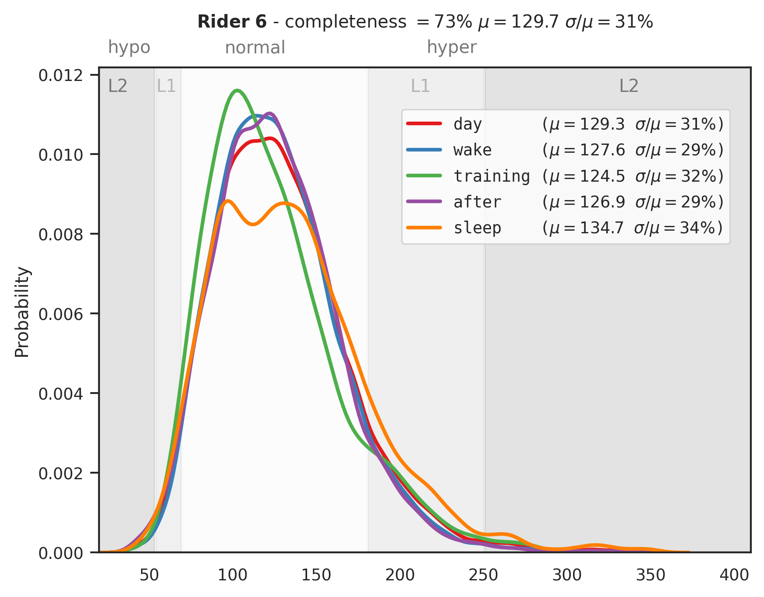
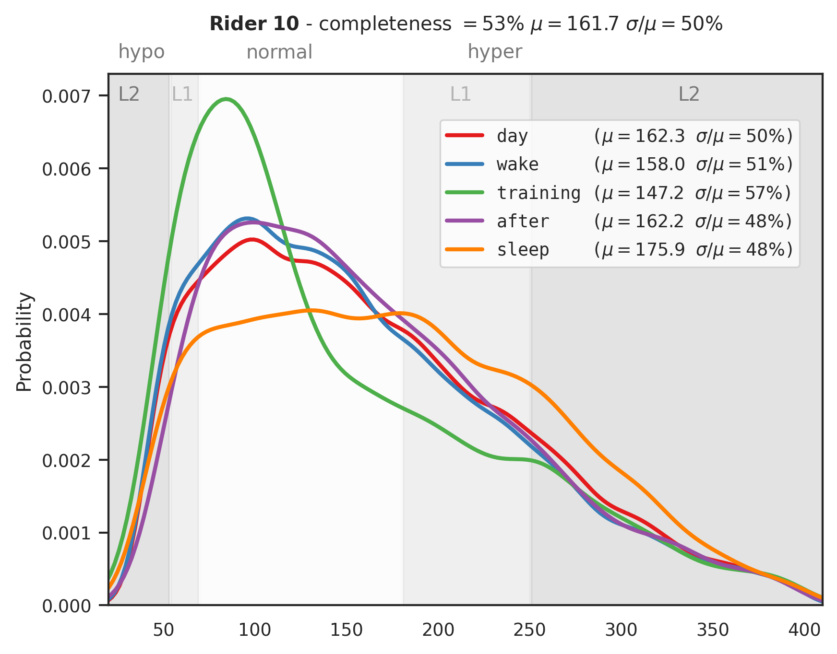
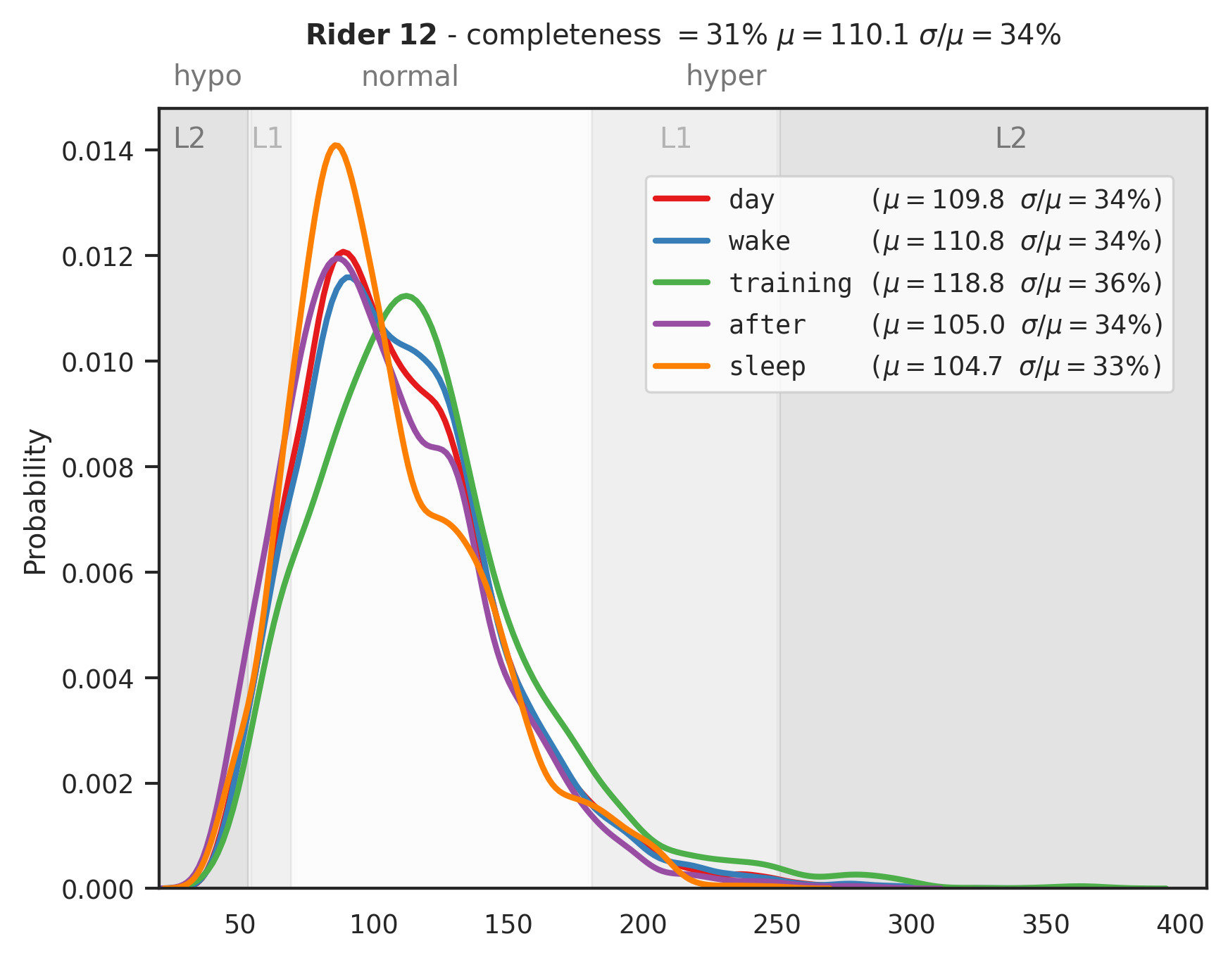
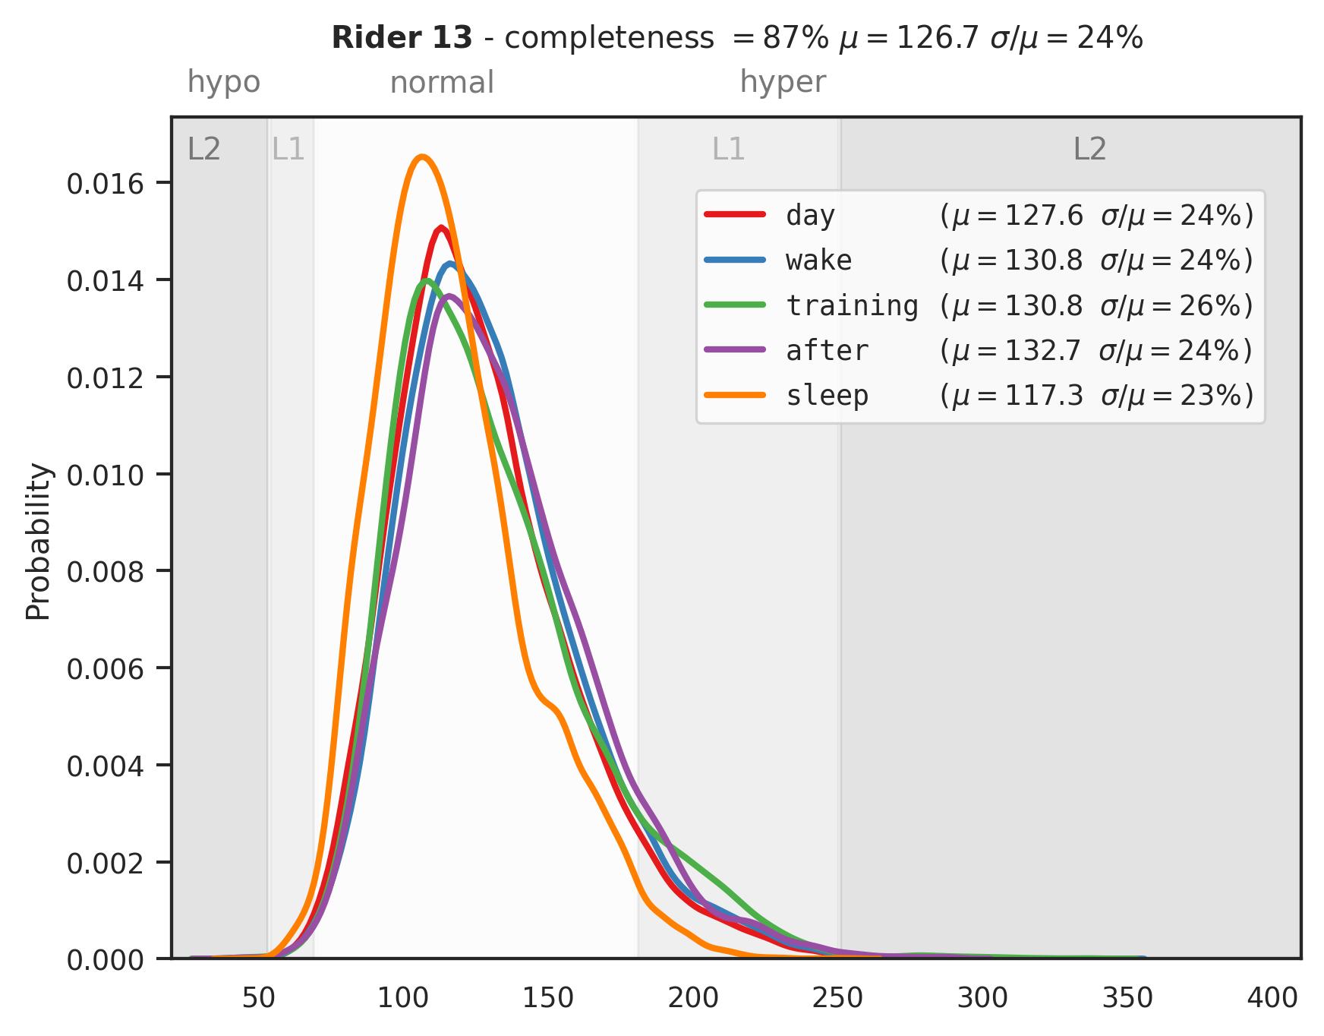
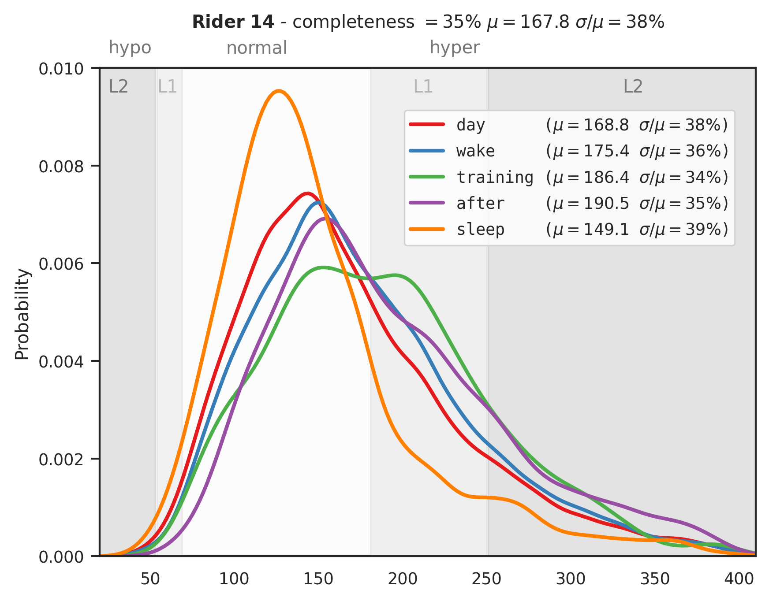
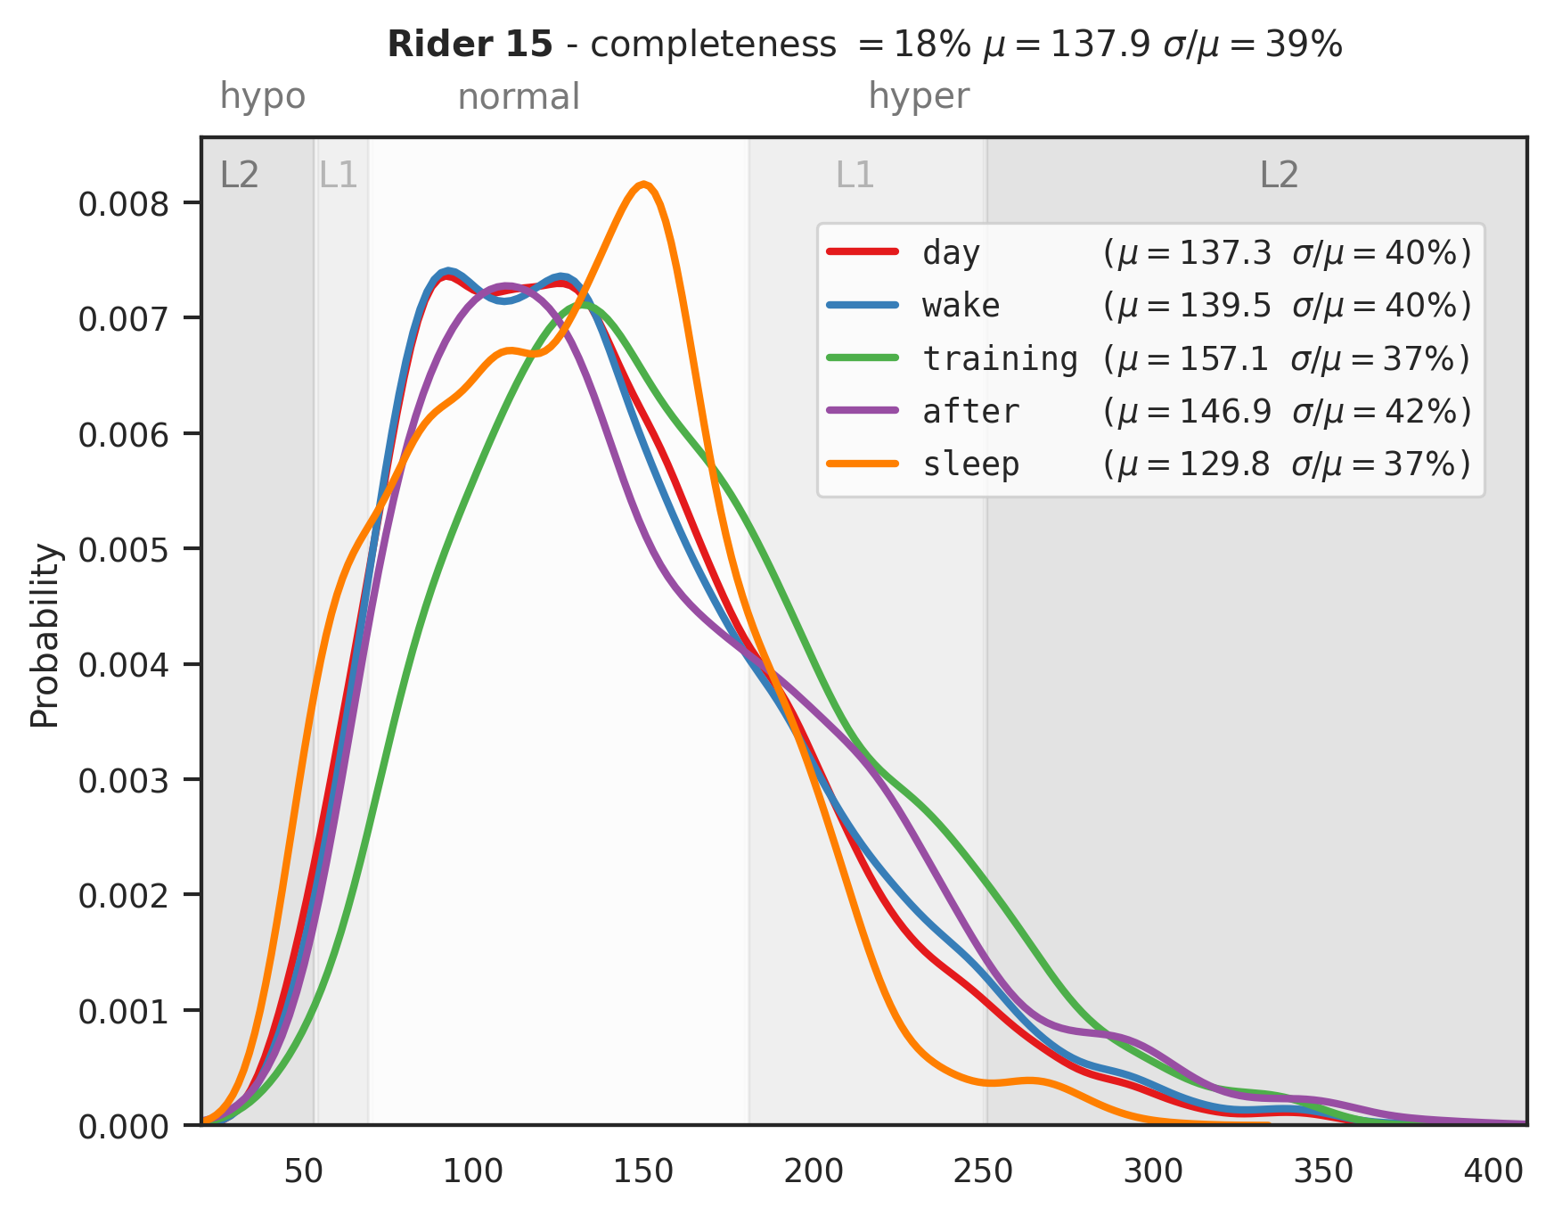

Slide 28


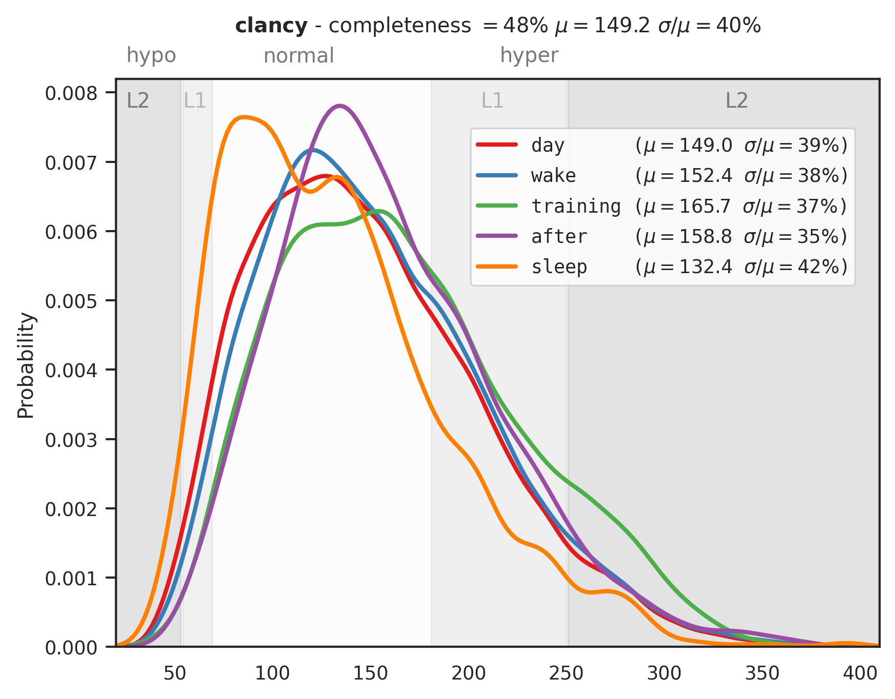
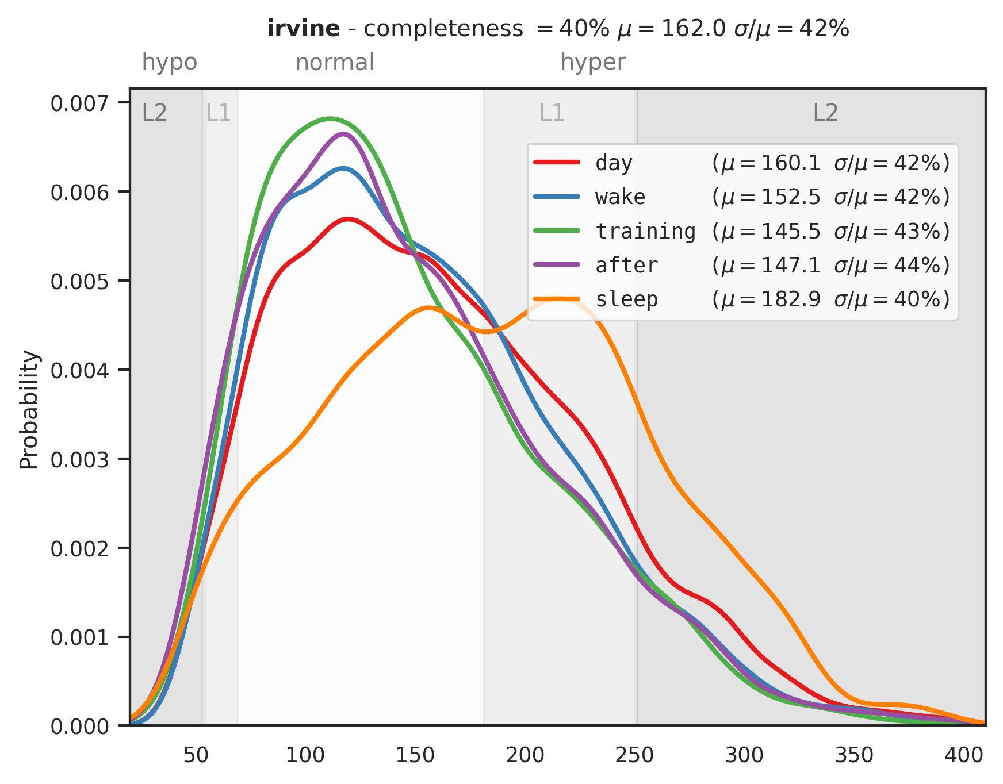
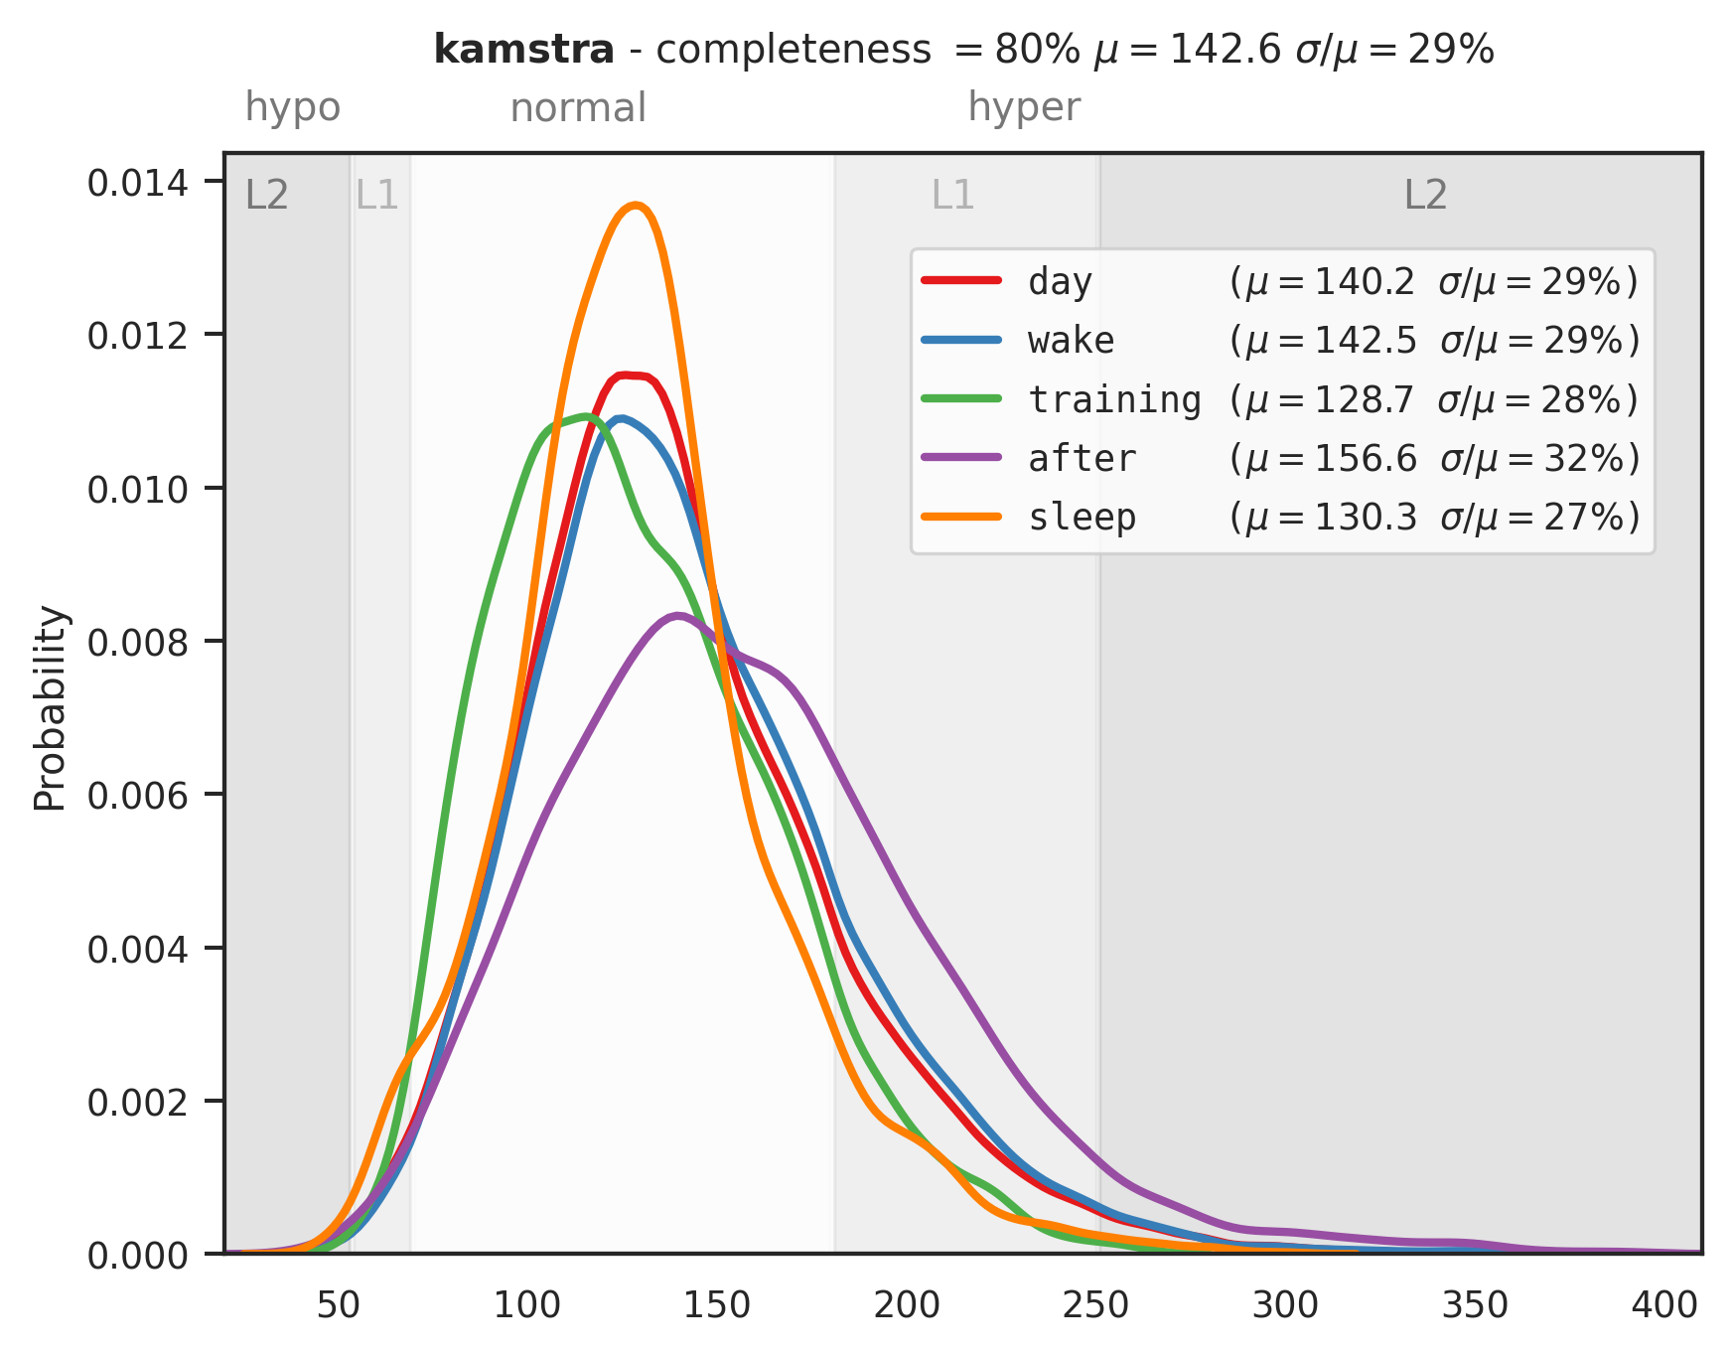

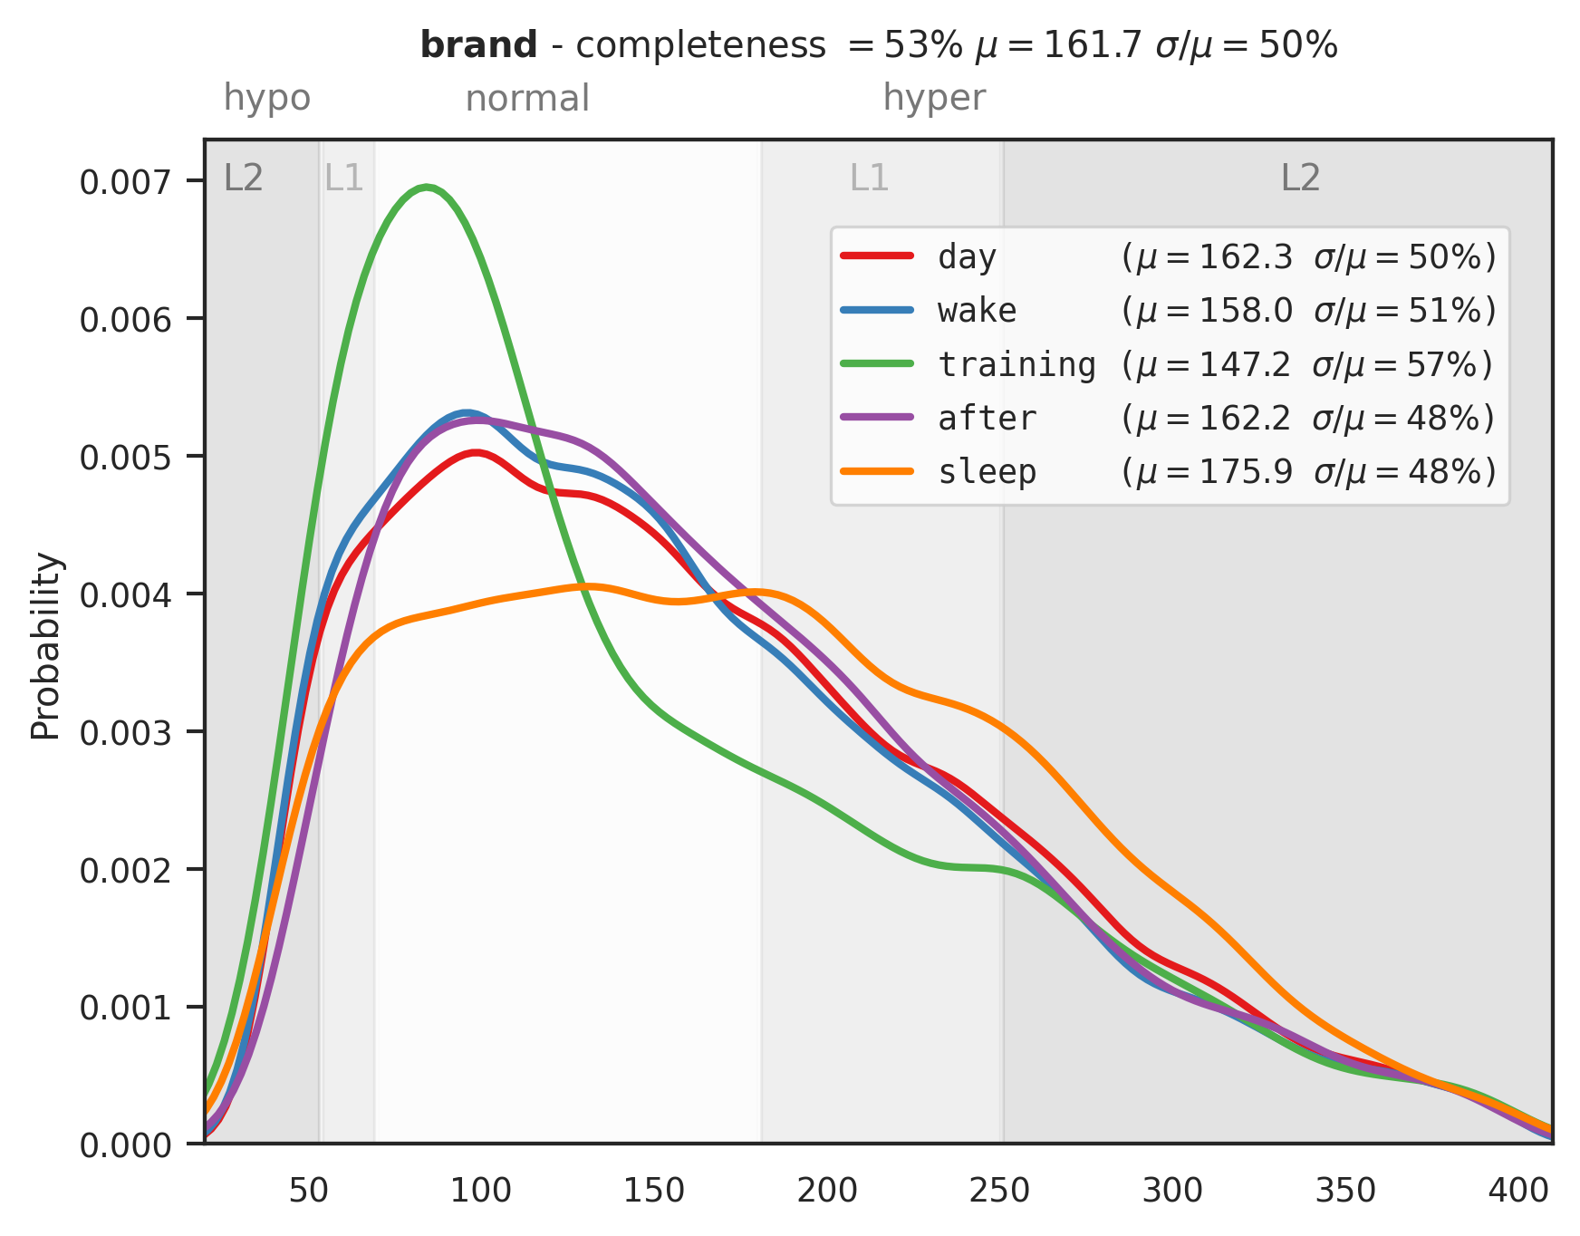
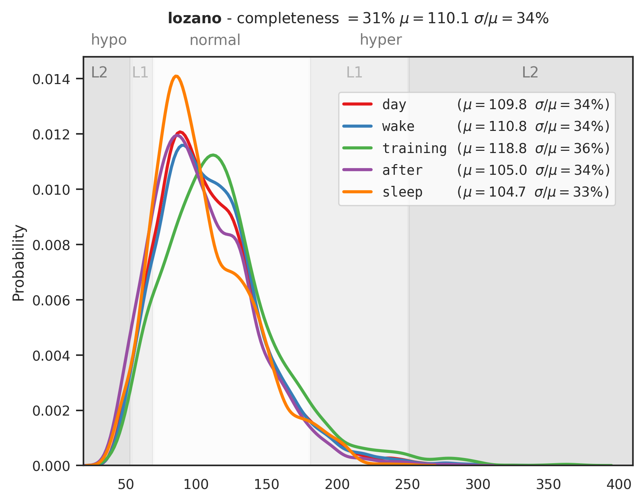




Slide 29
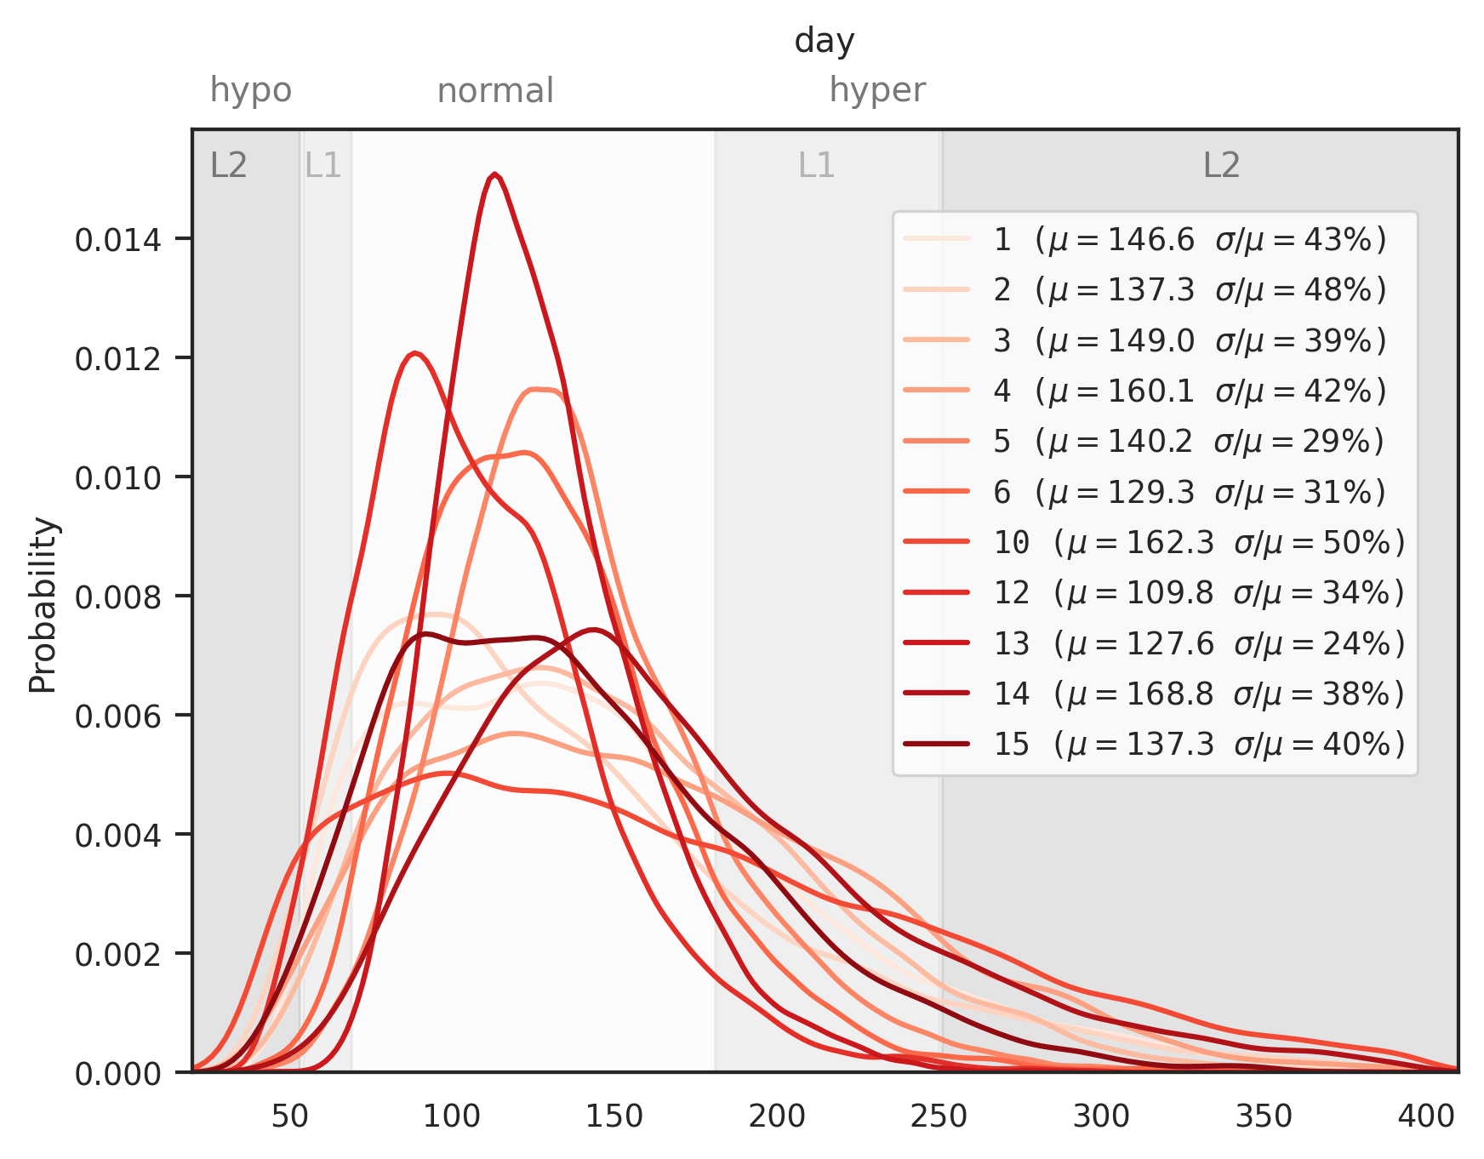
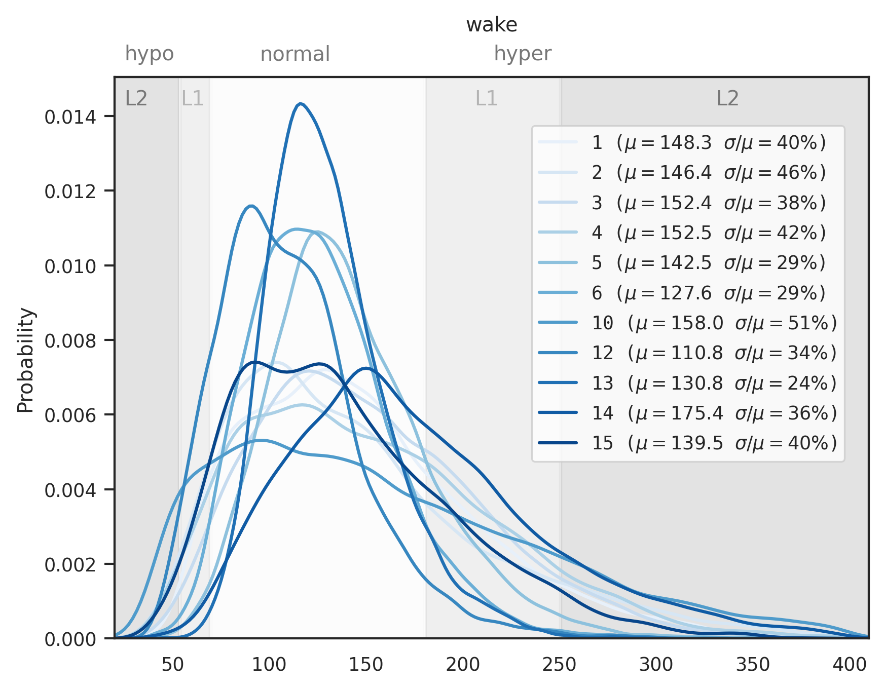
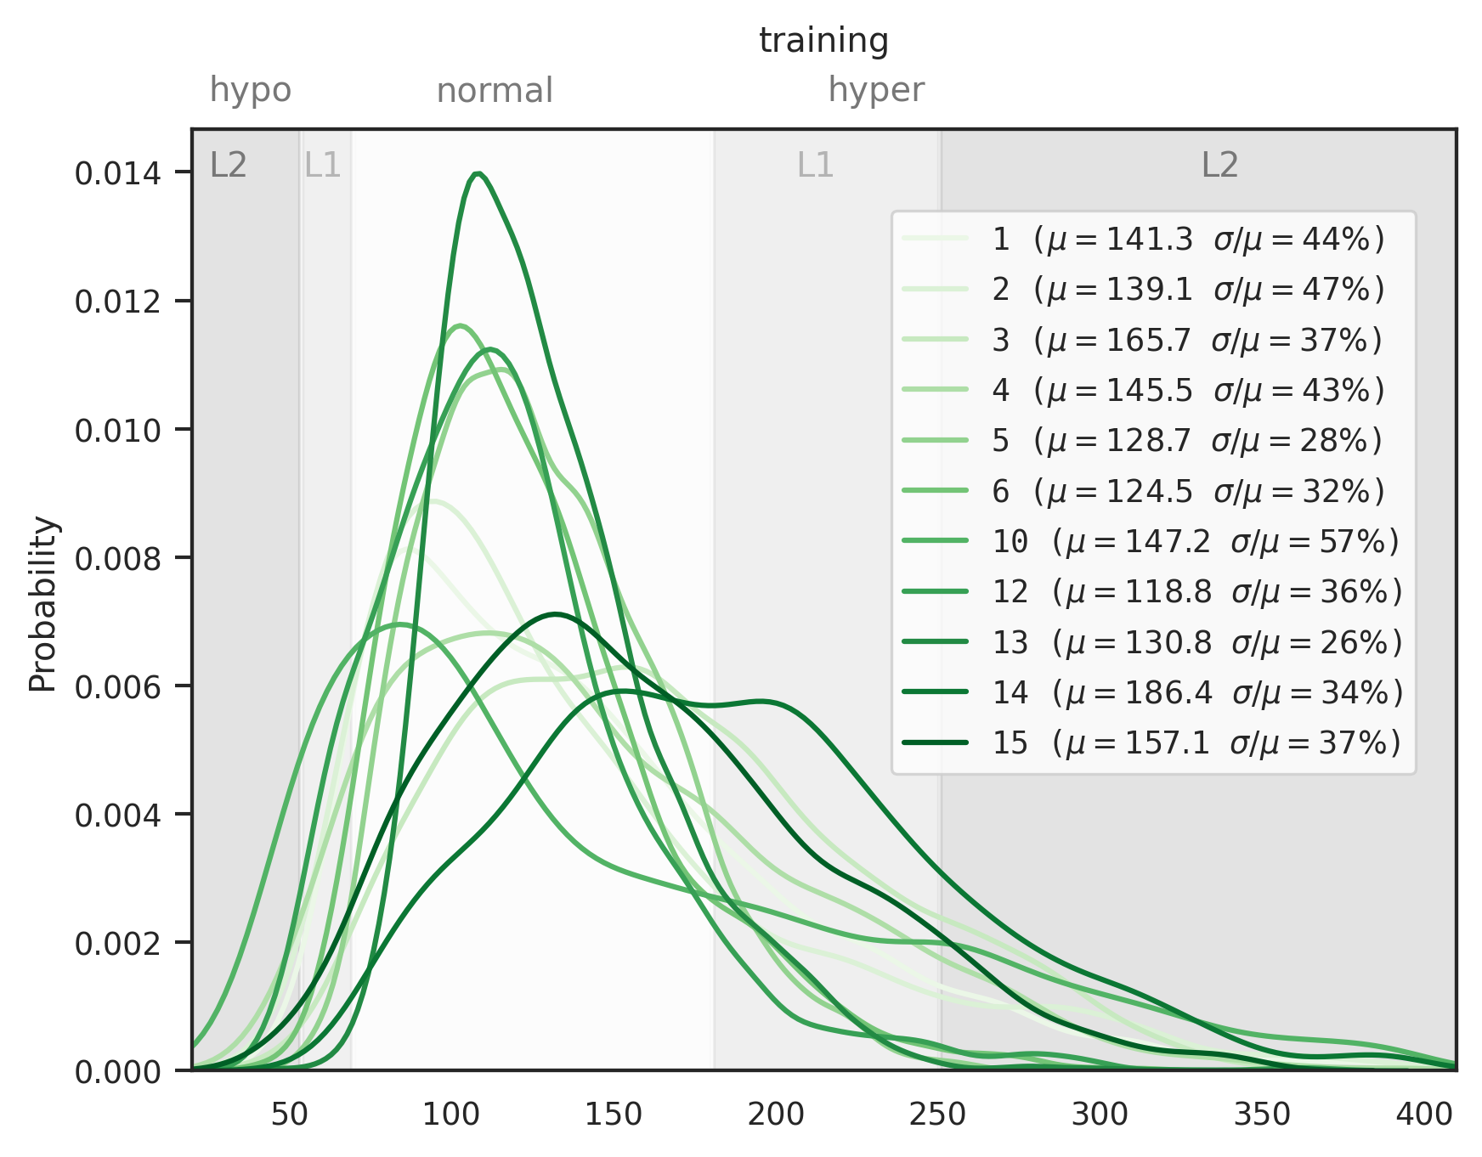
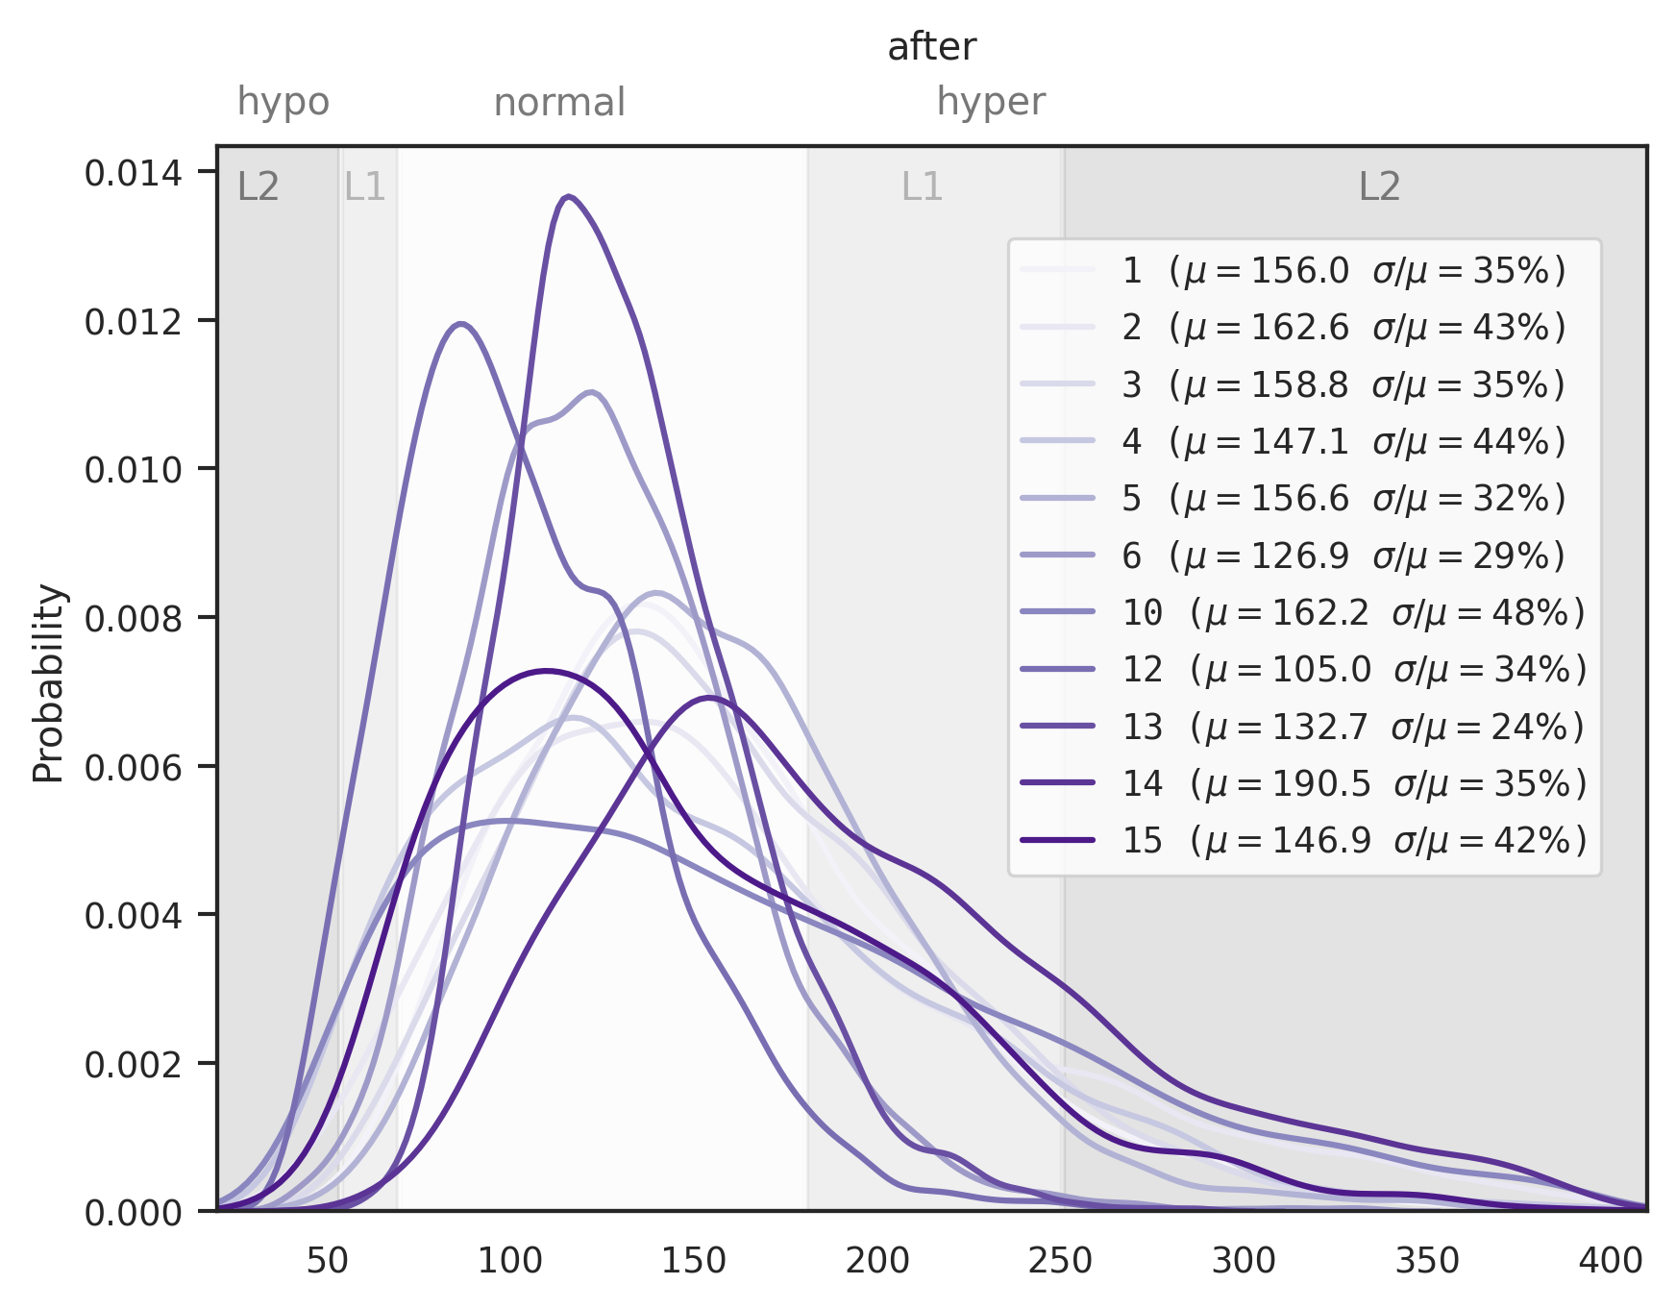
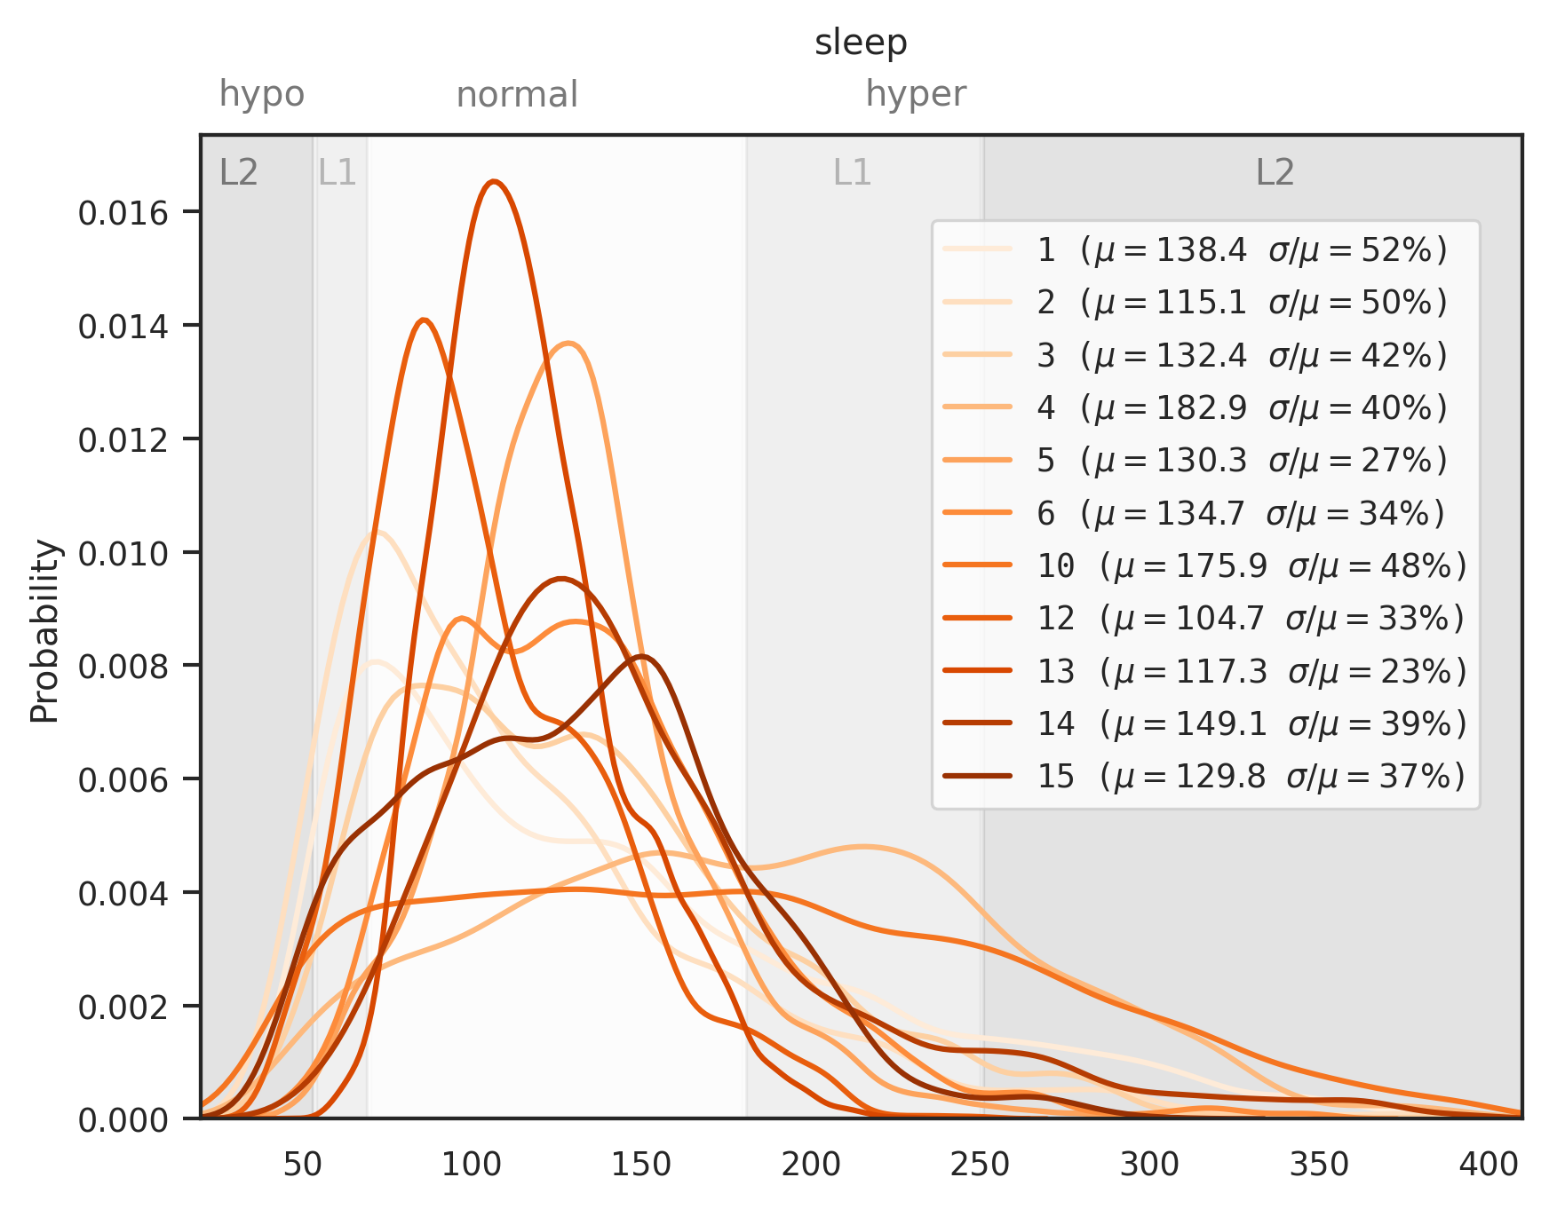

Slide 30
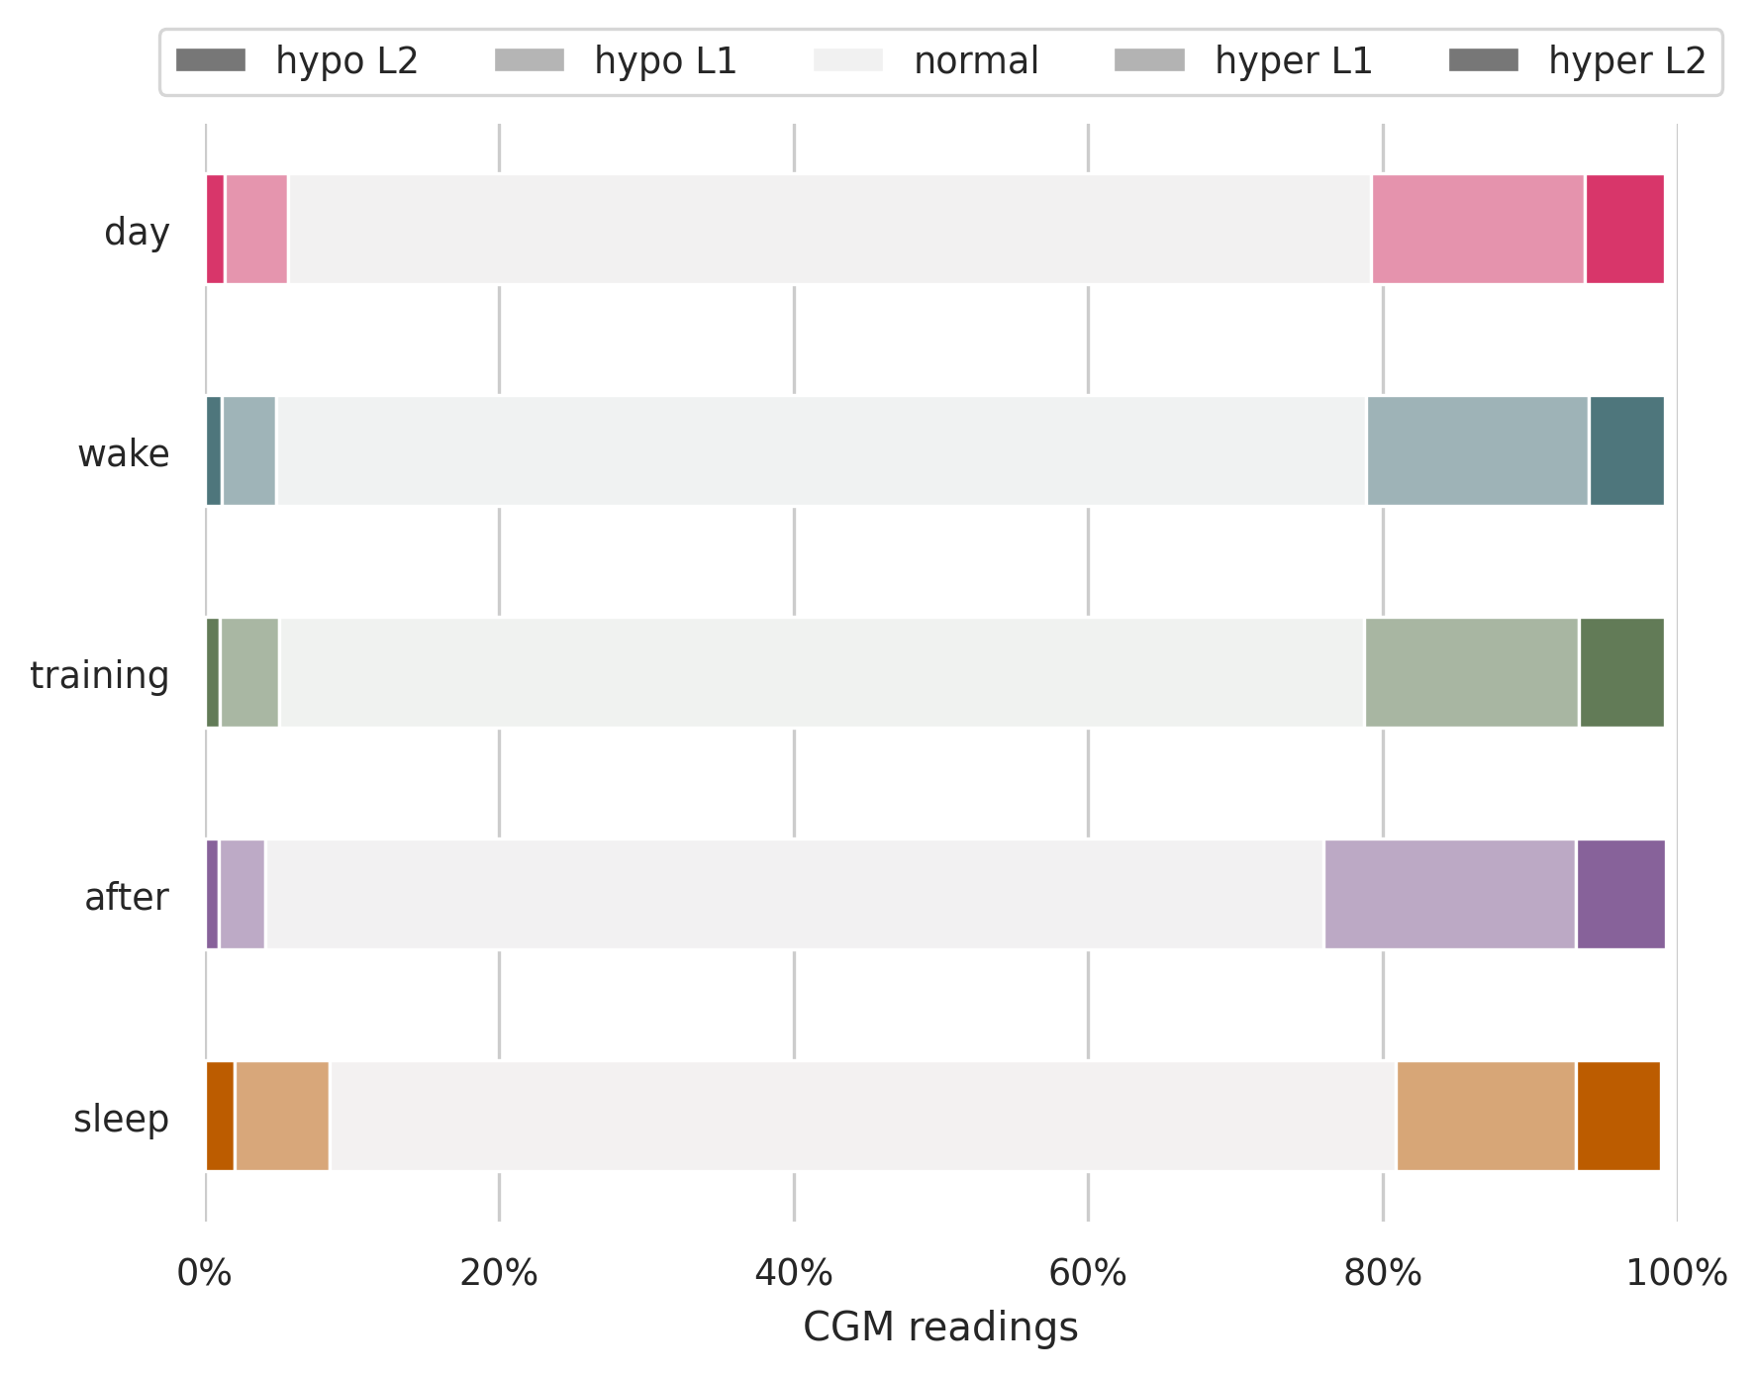
Percentage of CGM readings in glucose level
For all riders combined
⇒ stratify

Slide 31
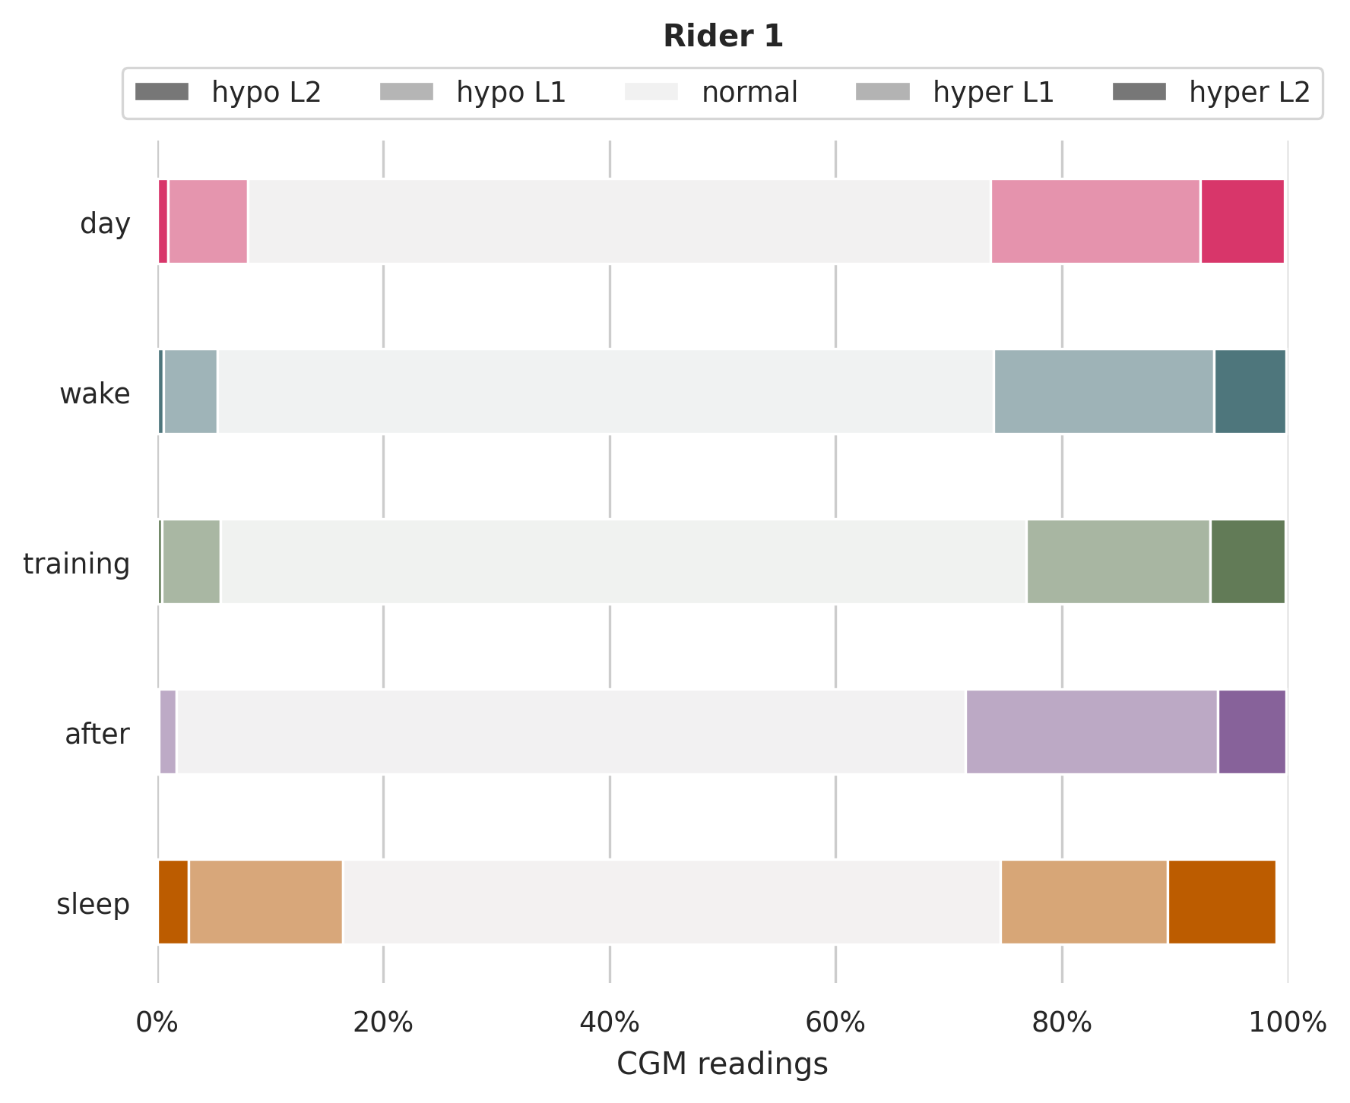
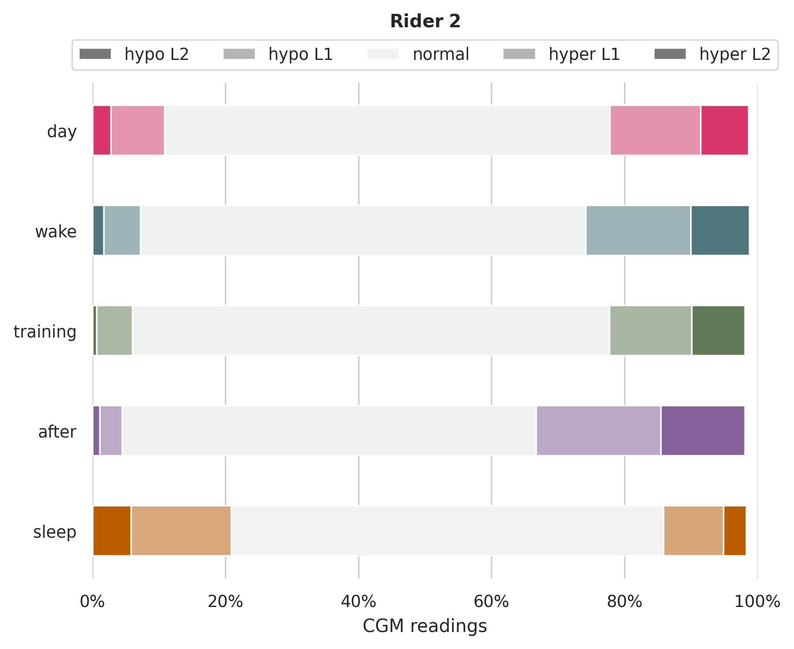
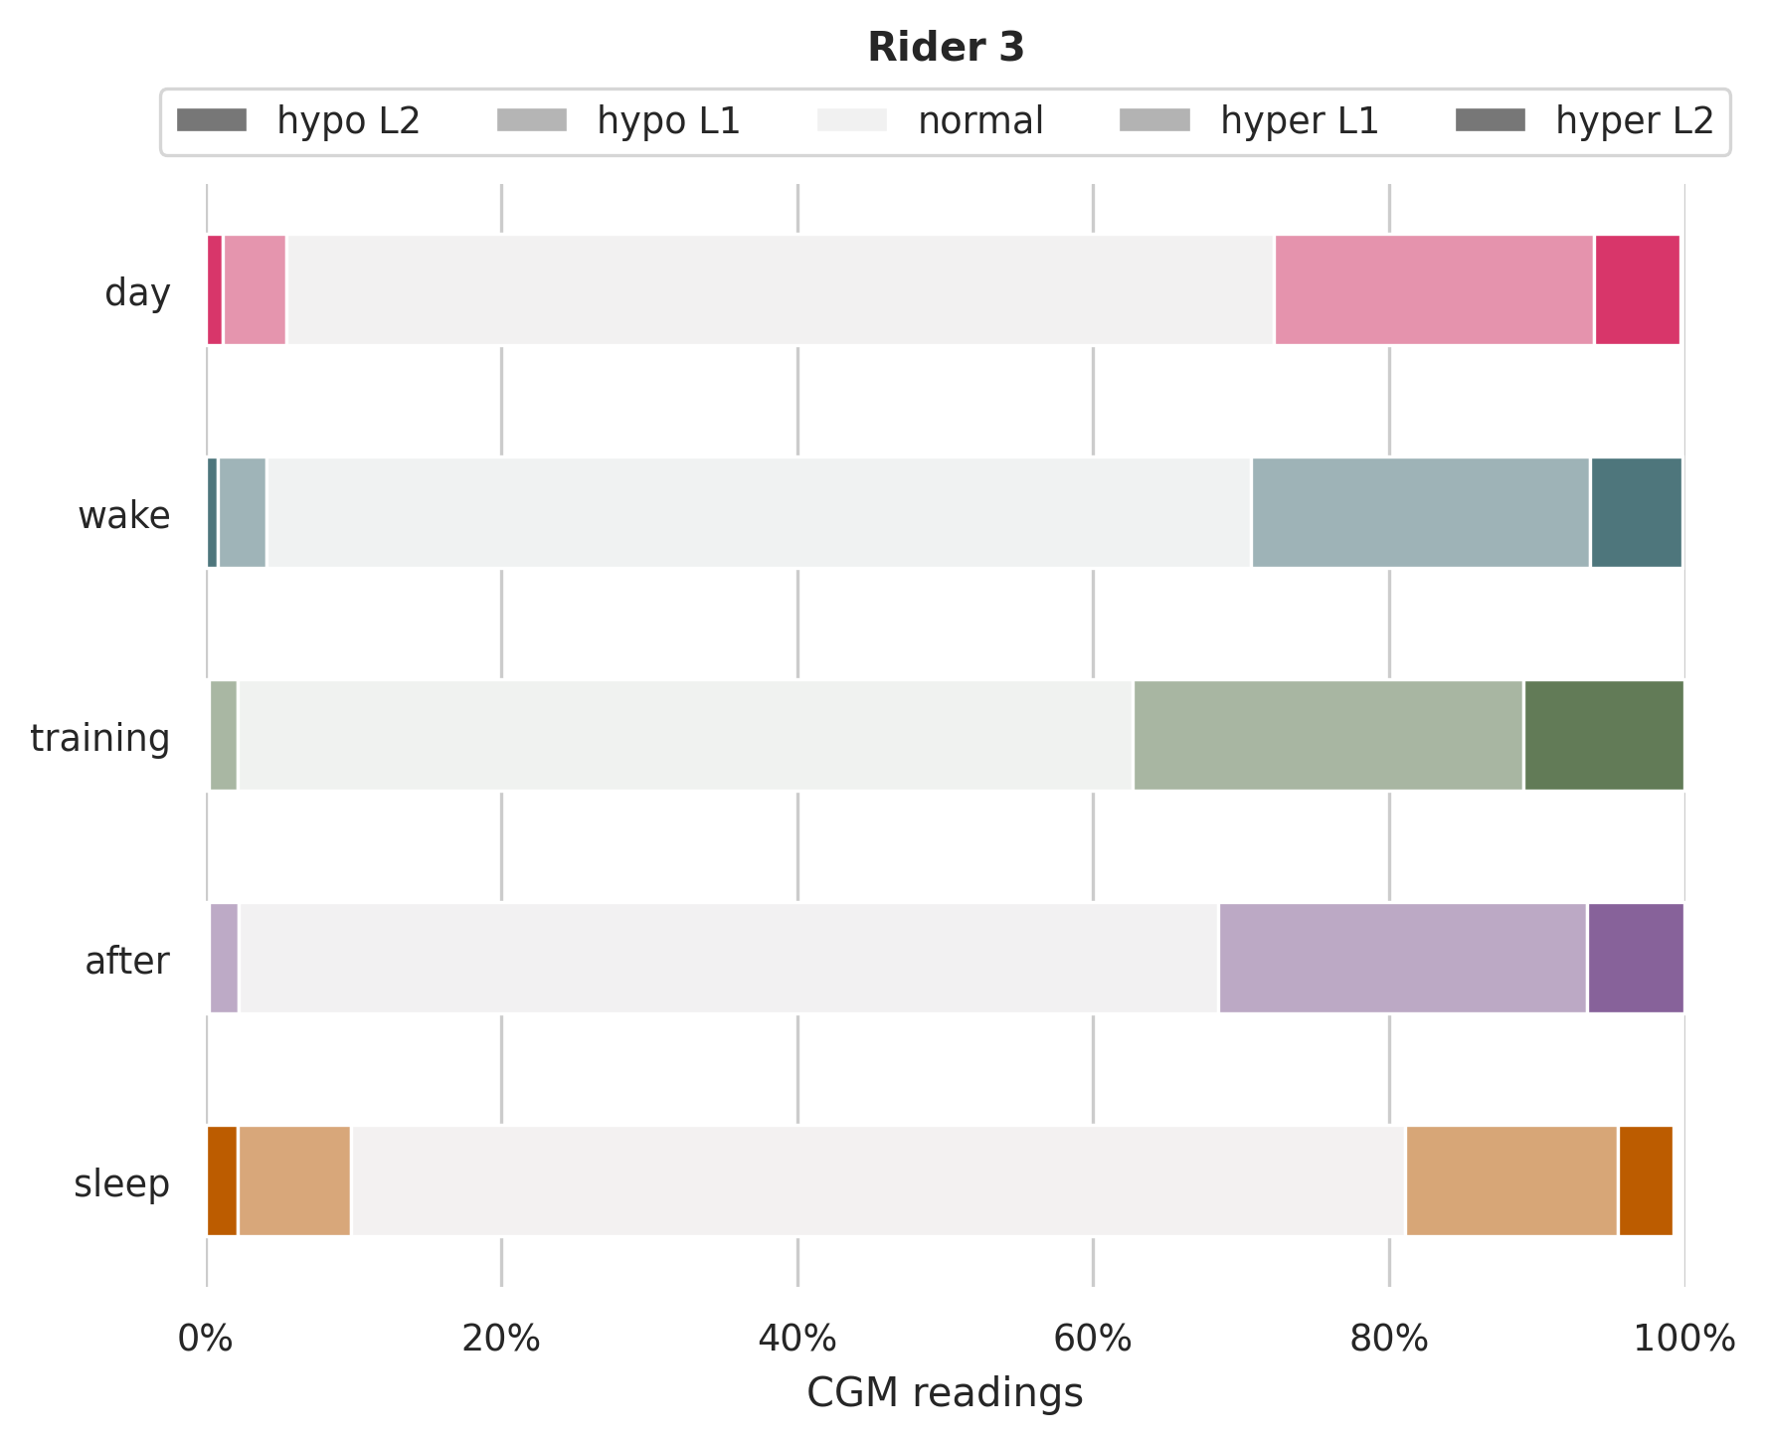
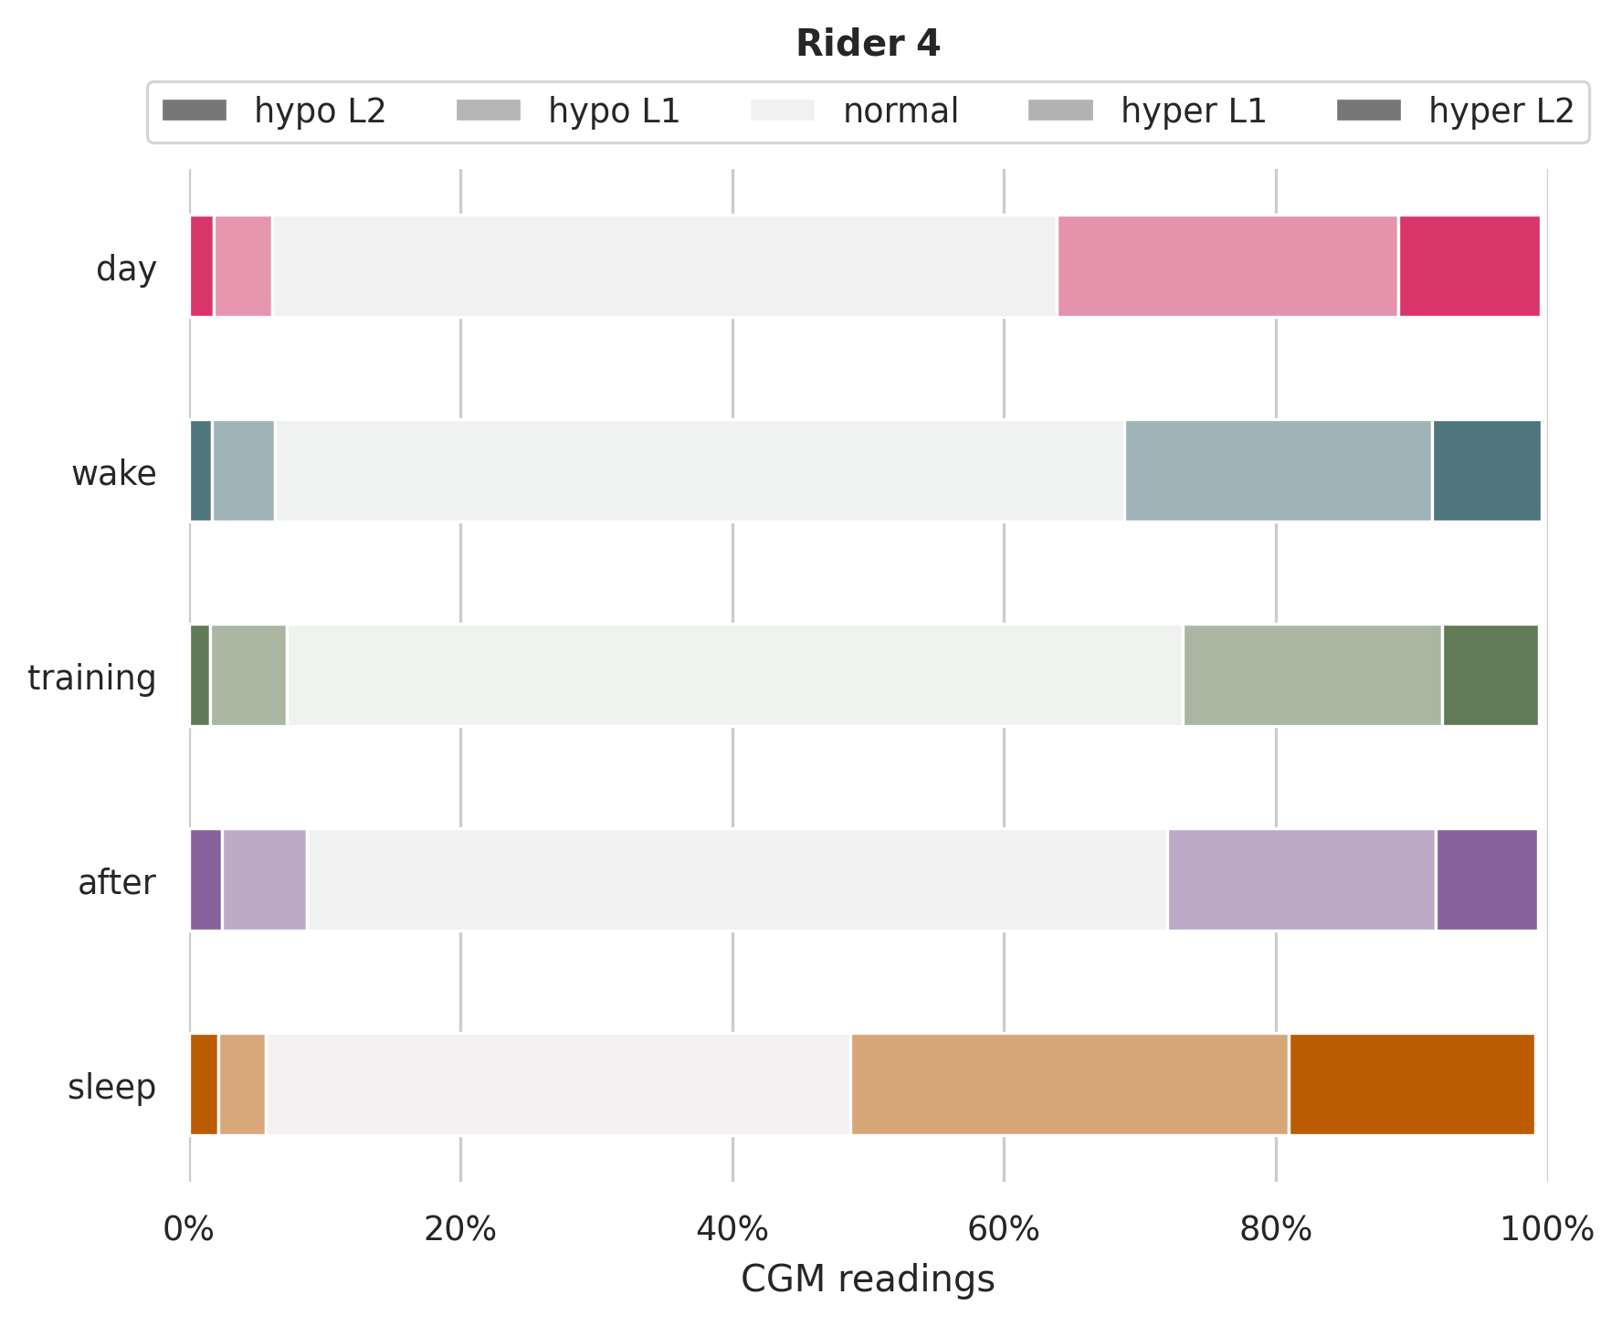
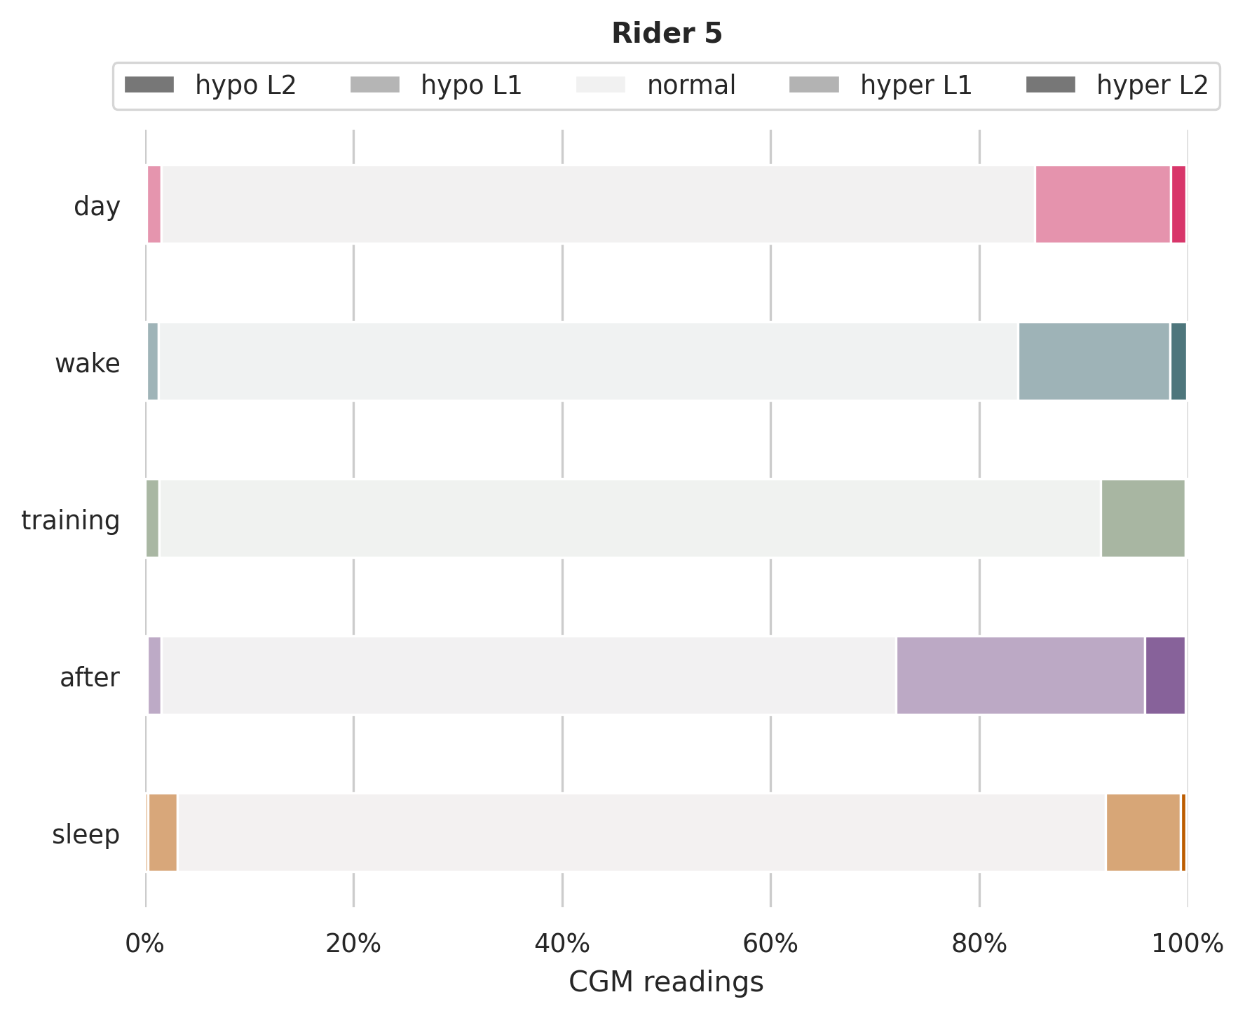
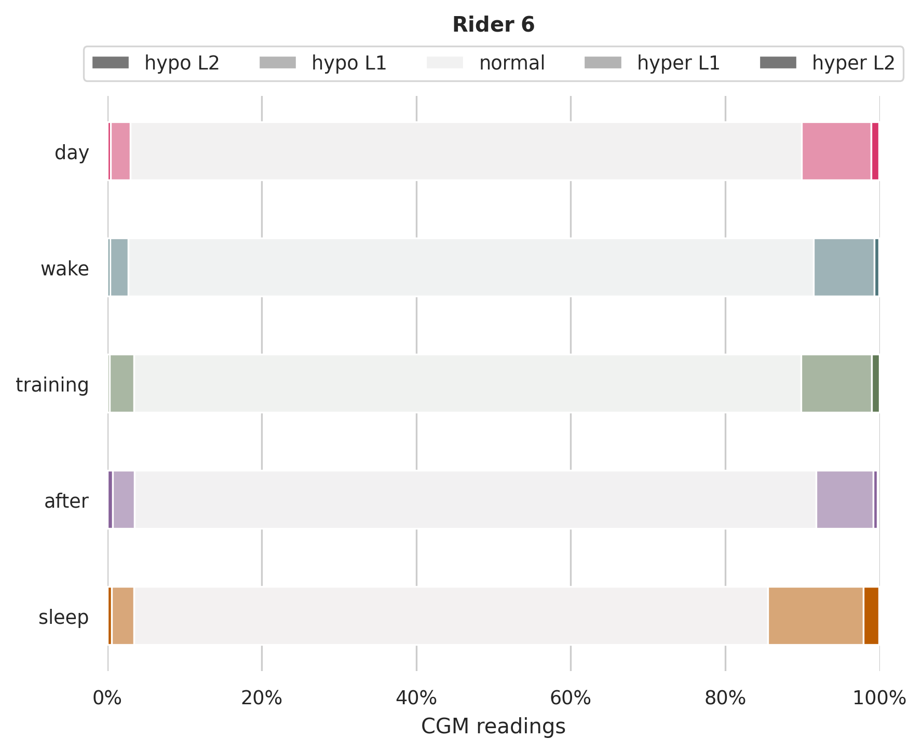
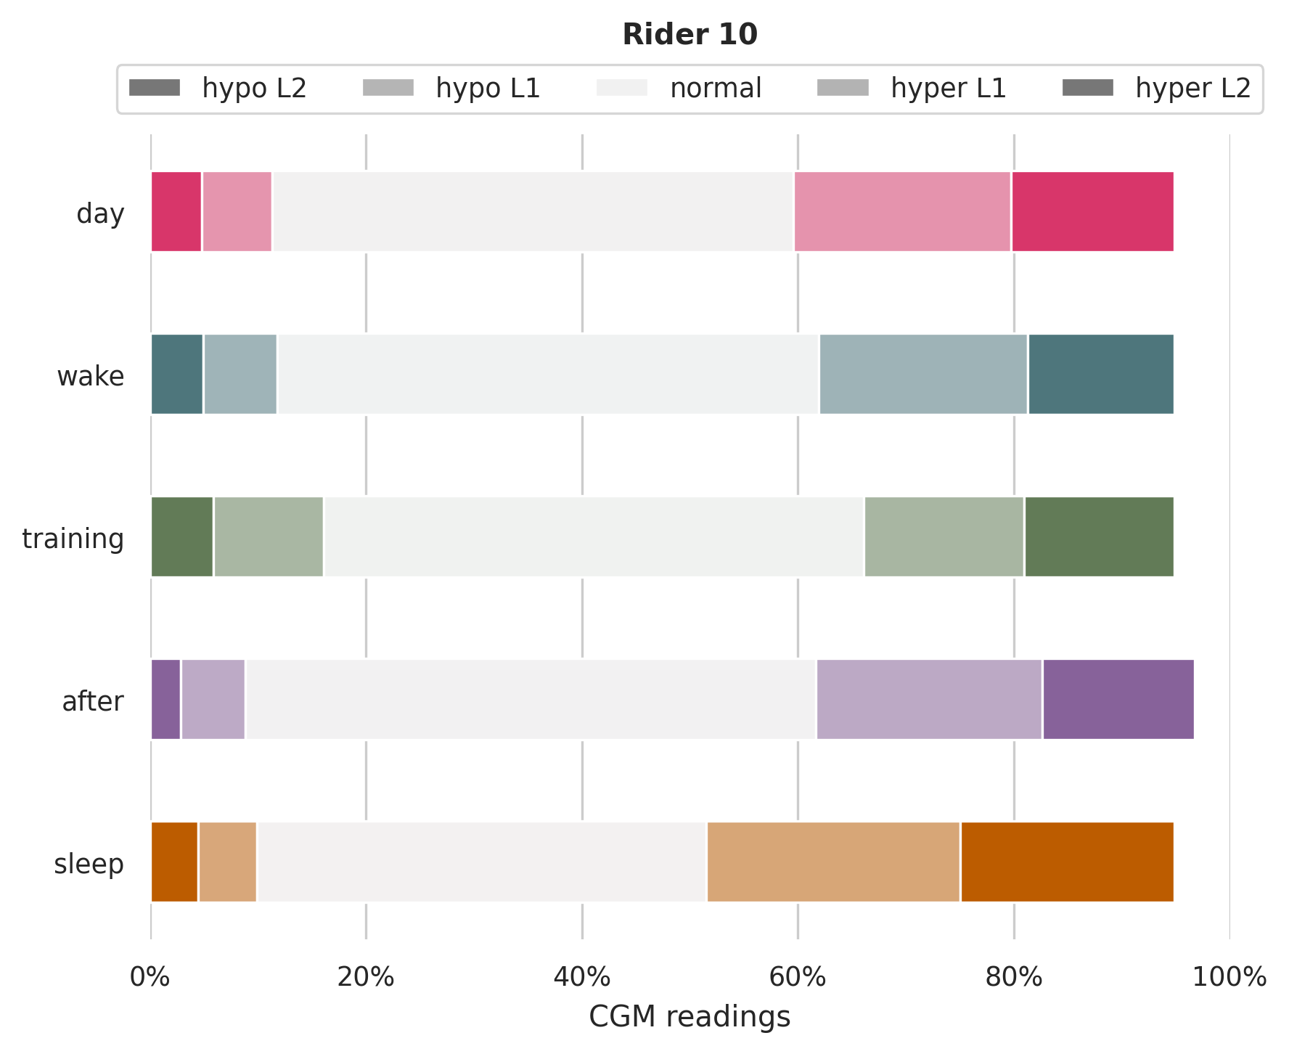
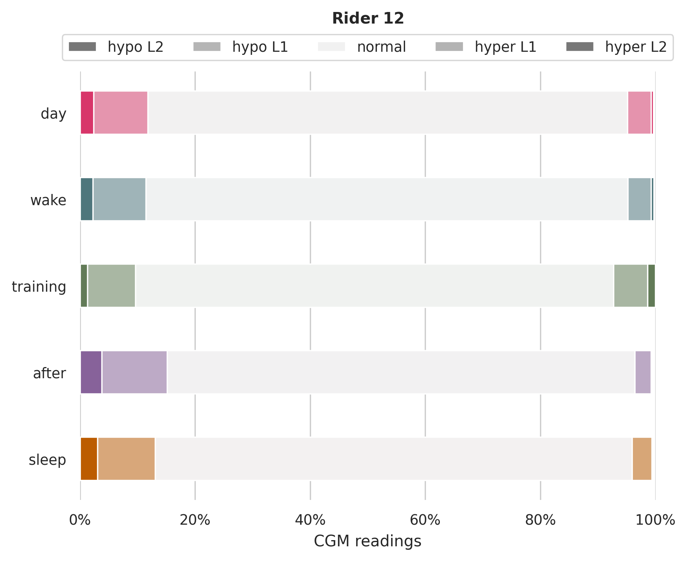
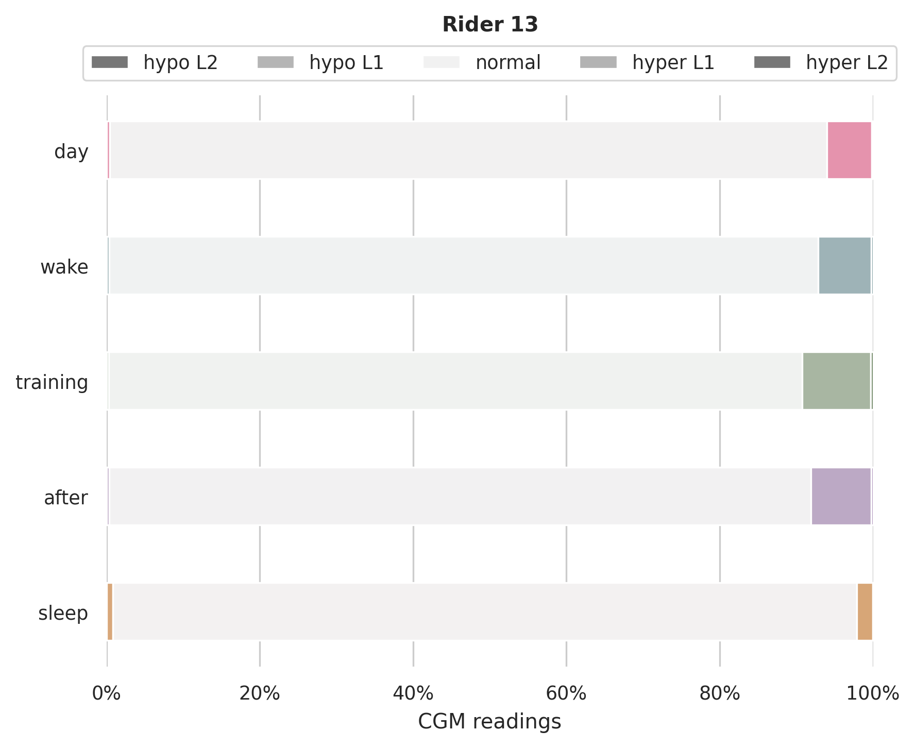
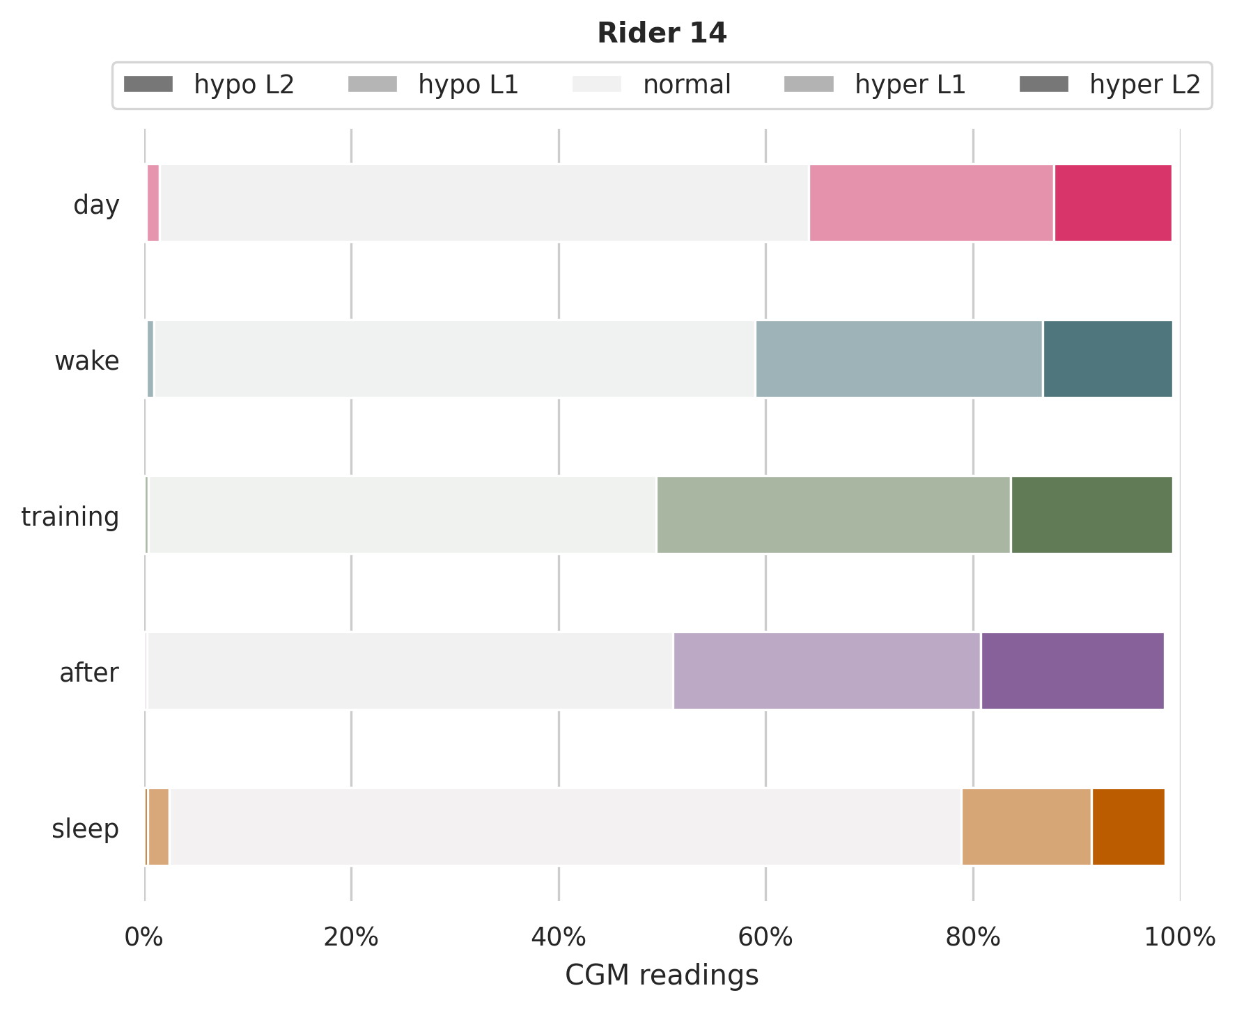
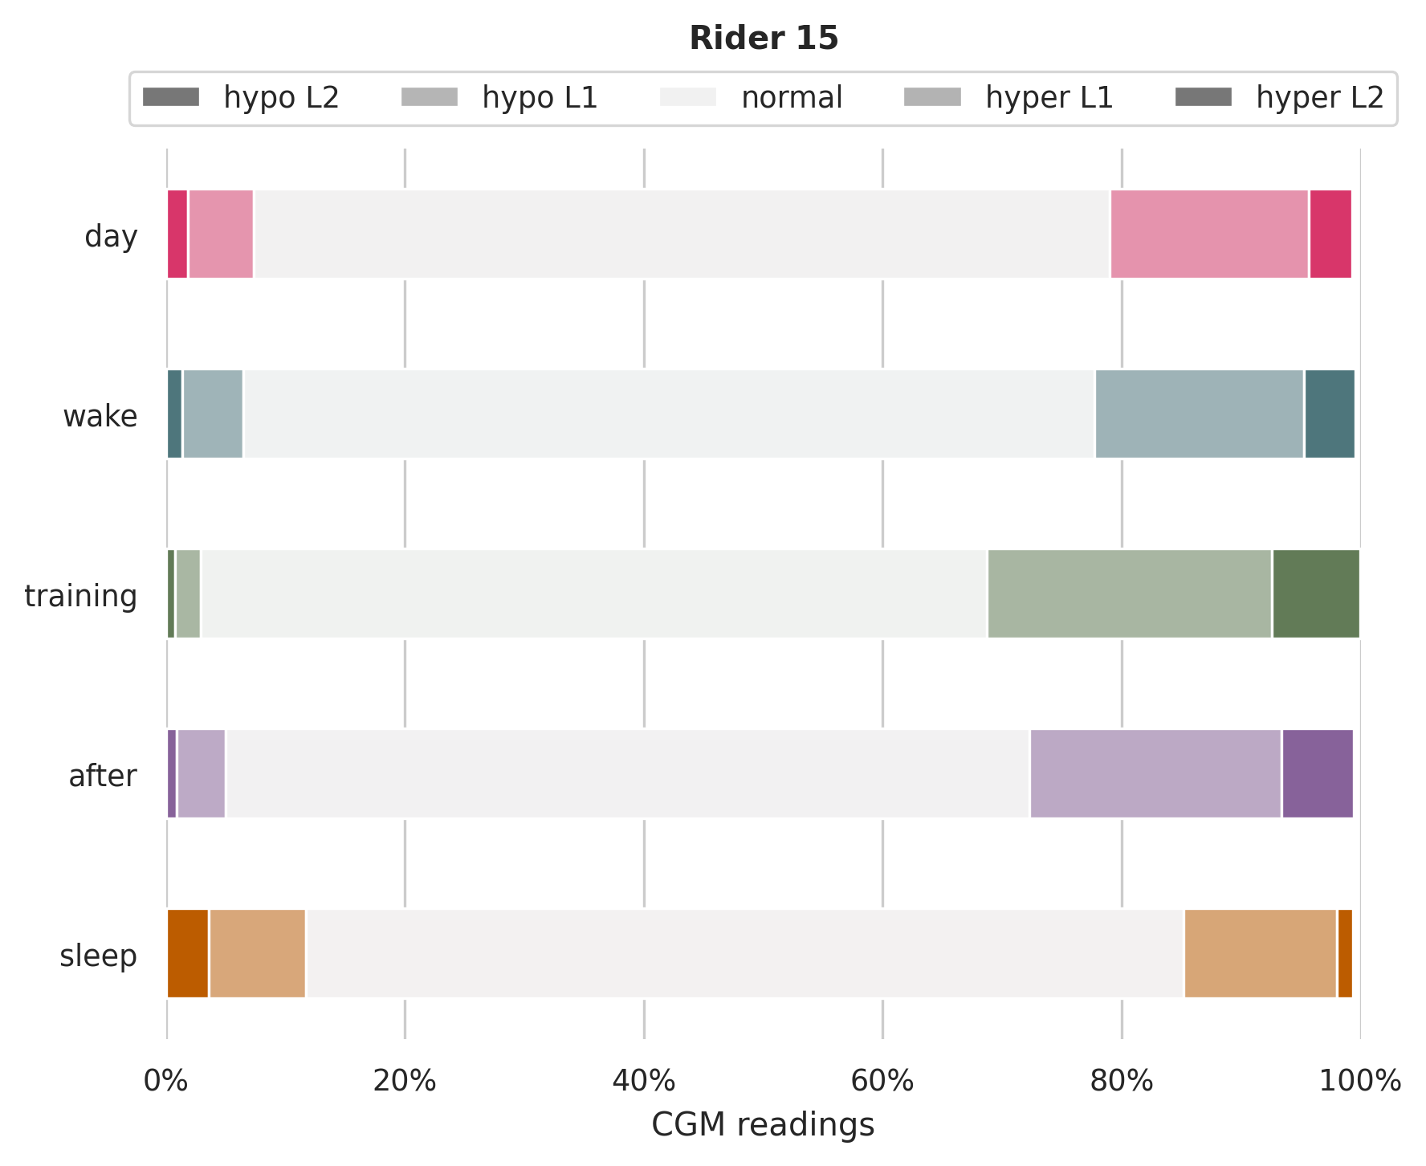

Slide 34
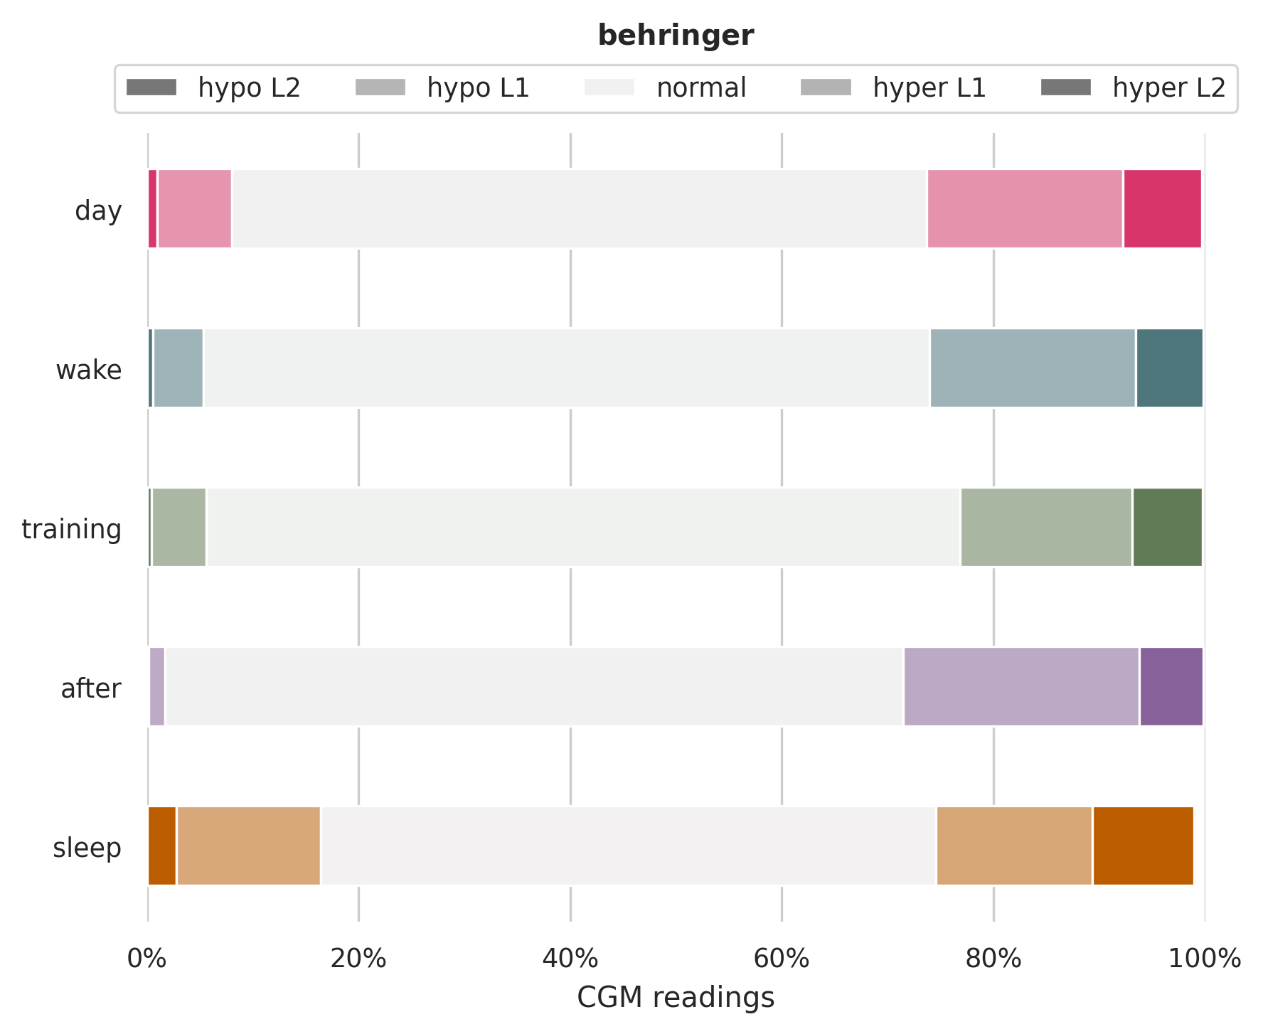
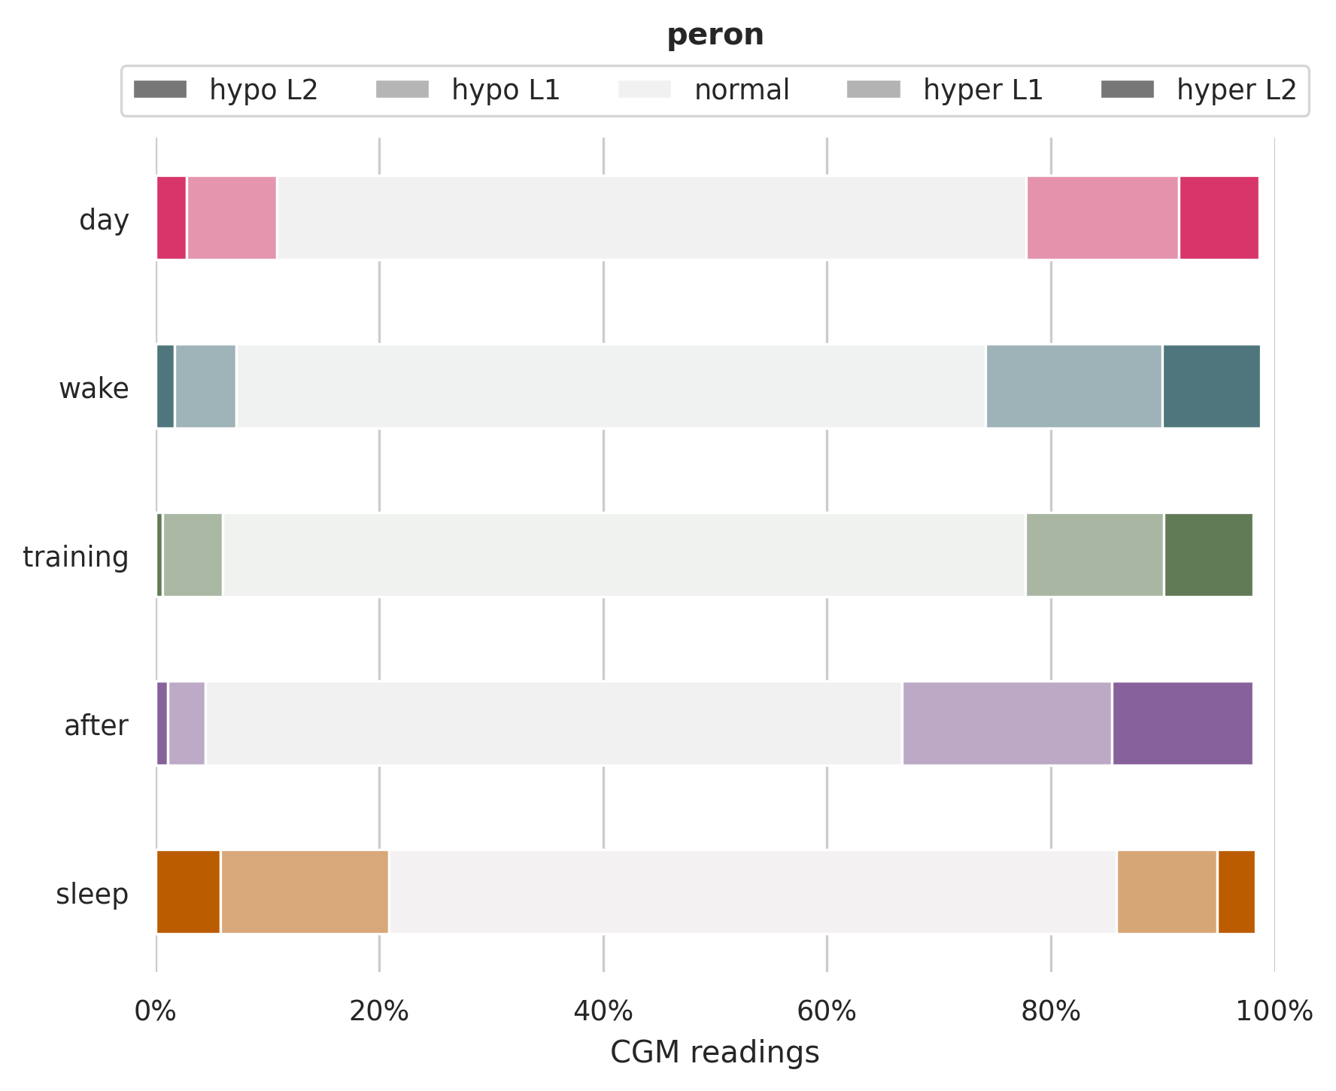

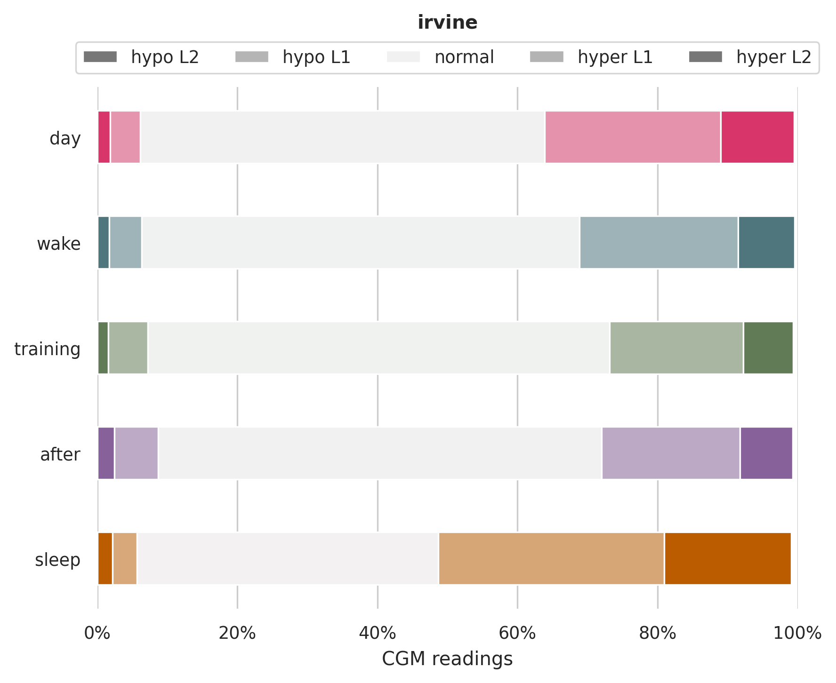


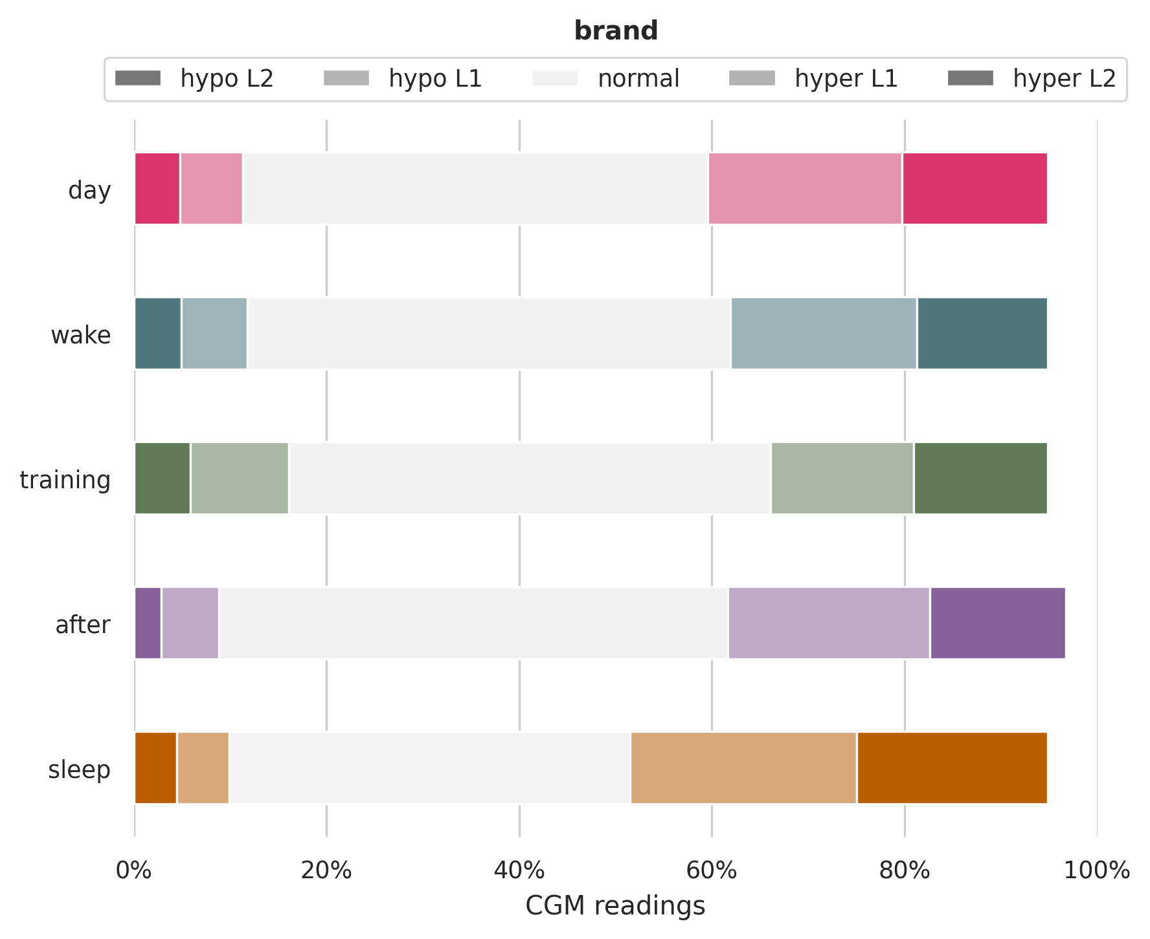
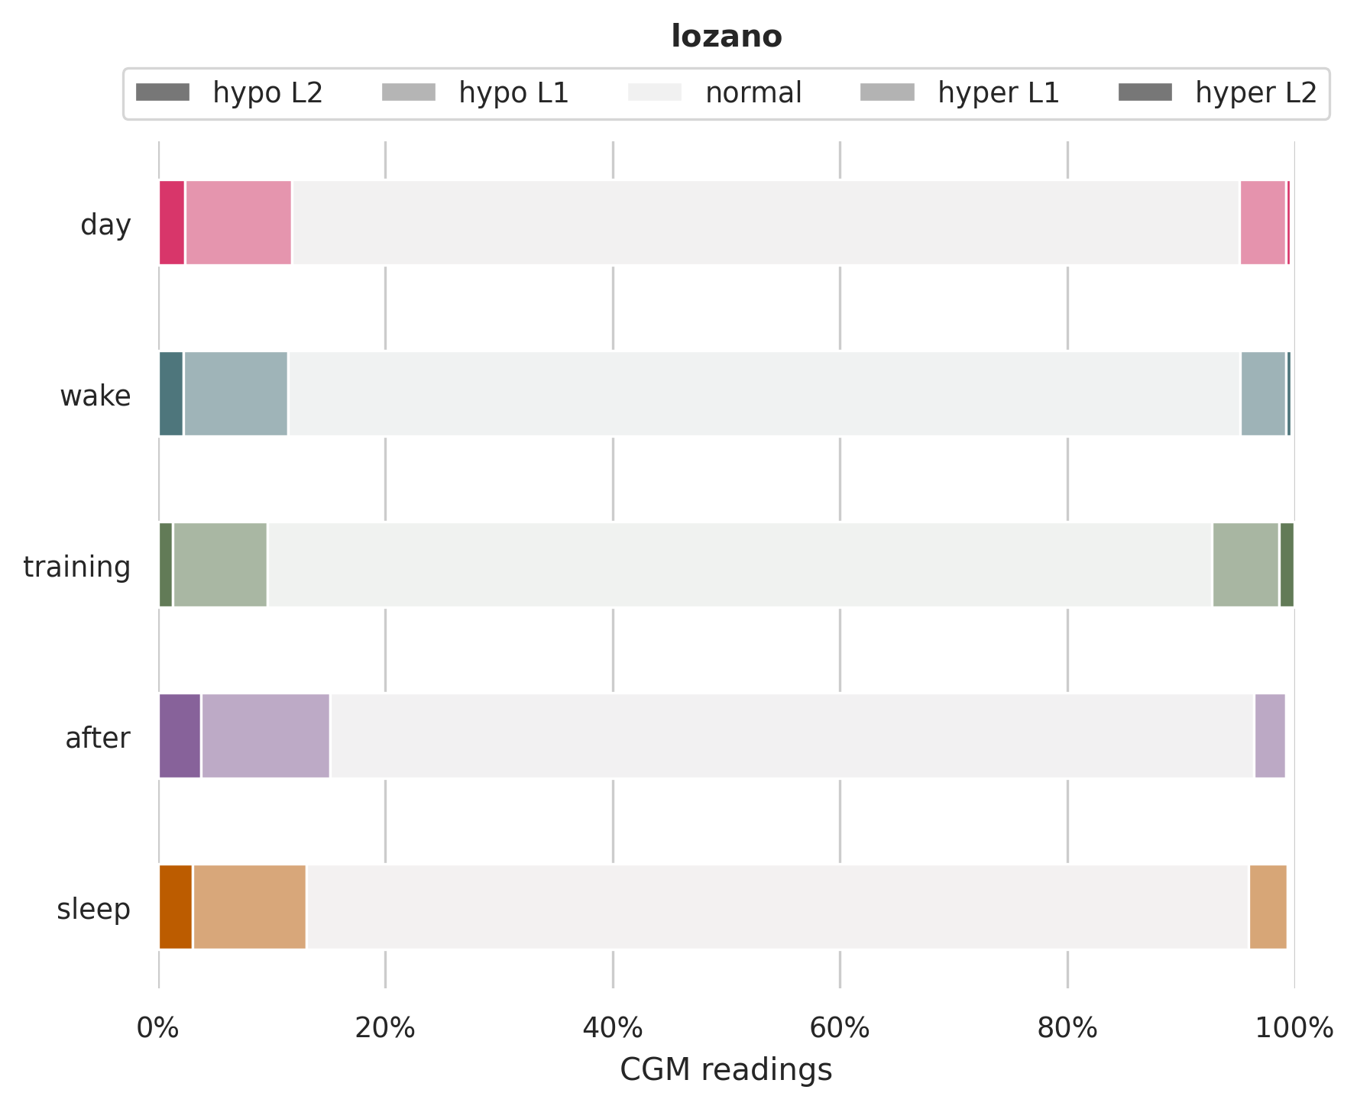




Slide 35
Any further glucose descriptives or ideas?
Area under the curve
Risk of hypoglycemia and hyperglycemia (?)

Slide 36
Training sessions

Slide 37
Correlations on a training session level
See if there are correlations between glucose (variability) and exercise variables
Exercise variables:
Data from trainingpeaks (i.e. from GPS, heart-rate meter and power meter)
Training session statistics (TSS, CTL, ATL, etc.)
[TODO] Rider statistics (VO2%max, HbA1c)
Current issues
Why is there sometimes zero output from the power meter, and how to treat this data
Impute glucose to calculate time in glucose levels. Use linear imputation?

Slide 38

TrainingPeaks: correlations
Features that are most correlated with mean and std of glucose values over a training session
TODO:
Include rider statistics
Impute glucose values so we can obtain time in glucose levels
Many other things (also mentioned before)
⇒ Figure is preliminary

Slide 39
Predict future glucose

Slide 40

Next steps
Model to predict future glucose
Sliding window approach to get historic information of features
Aggregation functions: sum, mean, median, std, iqr, min, max
How often should there be a new prediction? (every 1 min, every 5 min?)
If every 1 min, linearly interpolate glucose values?

